Slide 1
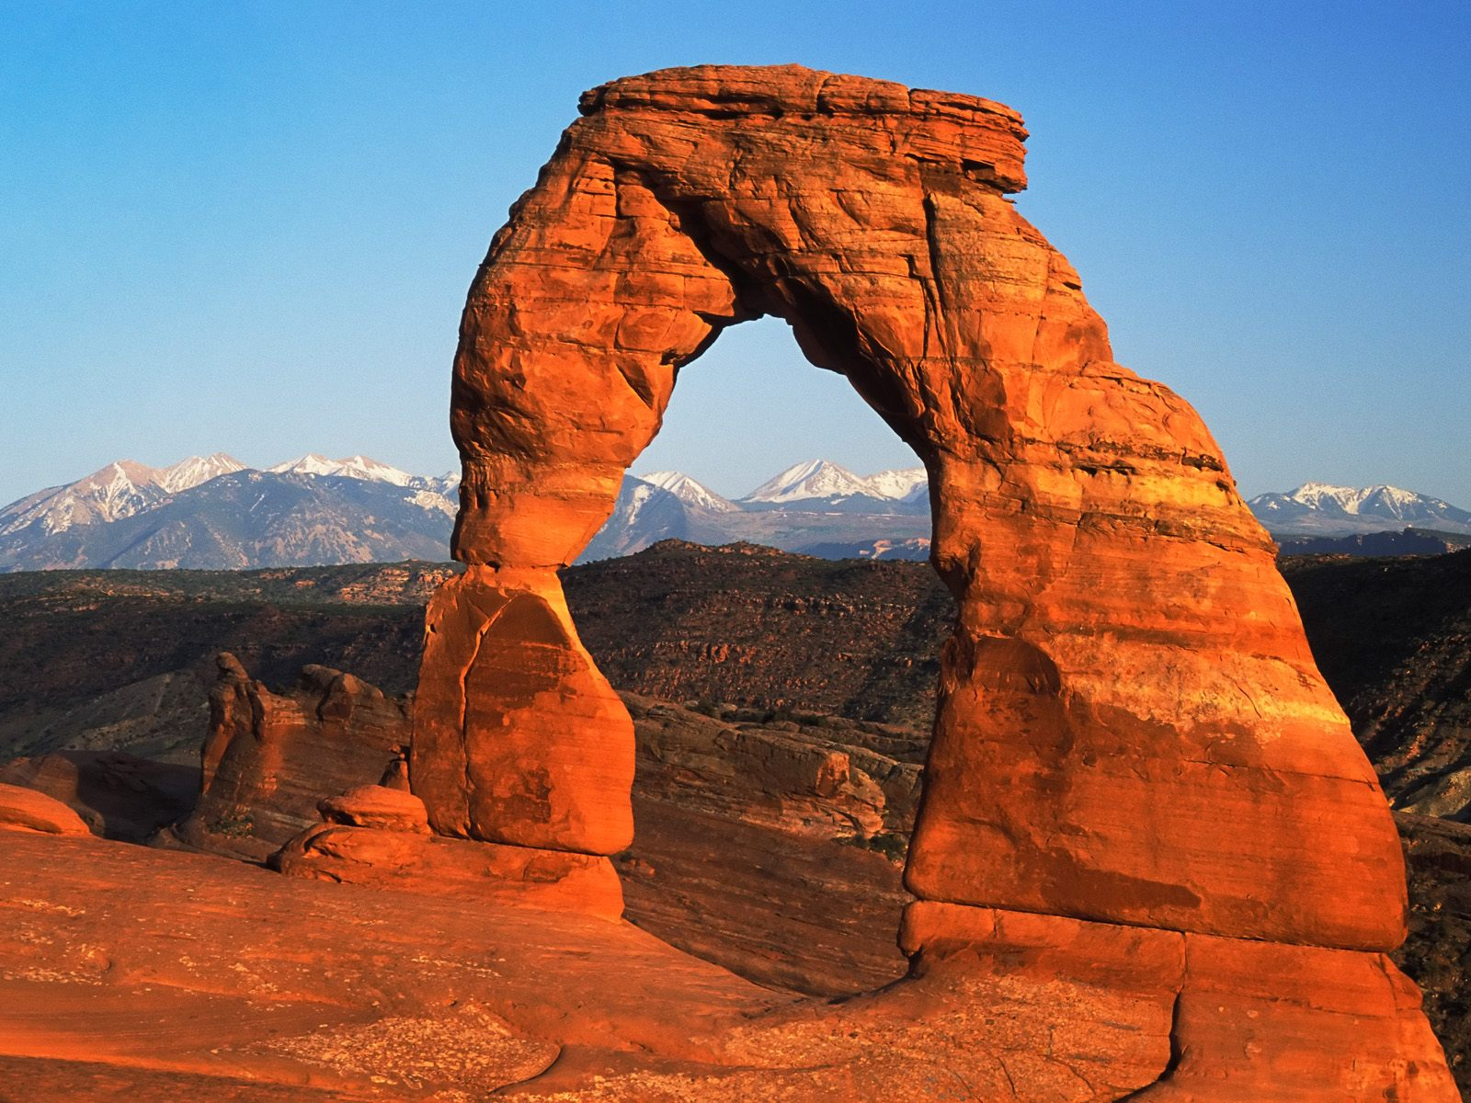
Weathering

Slide 2
Rocks and minerals Review!
Quartz-a mineral resistant to mechanical and chemical weathering
Silicates-a strong “glue” that enables sedimentary rock to resist weathering
Sedimentary rocks that weather quickly contain calcite.

Slide 3
Rocks and minerals Review!
Most are deep within Earth’s crust formed under extreme conditions of temperature and pressure.
Rocks that are uplifted to the surface are exposed to gases and water in Earth’s atmosphere.

Slide 4
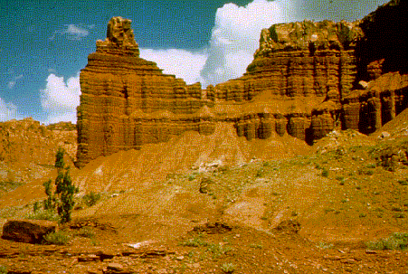
What is weathering?
the natural process by which atmospheric and environmental agents, such as wind, rain, and temperature changes, disintegrate and decompose rocks
Two types –
mechanical
chemical

Slide 5
Mechanical Weathering
the process by which rocks break down into smaller pieces by physical means (also called physical weathering)
strictly a physical process and does not change the composition of the rock.
Common agents: ice, plants and animals, gravity, running water, and wind.

Slide 6
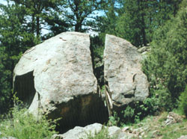
Mechanical - Ice Wedging
Agents: ice
occurs in cold climates when water seeps into the cracks in rock and freezes.

Slide 7
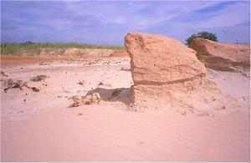
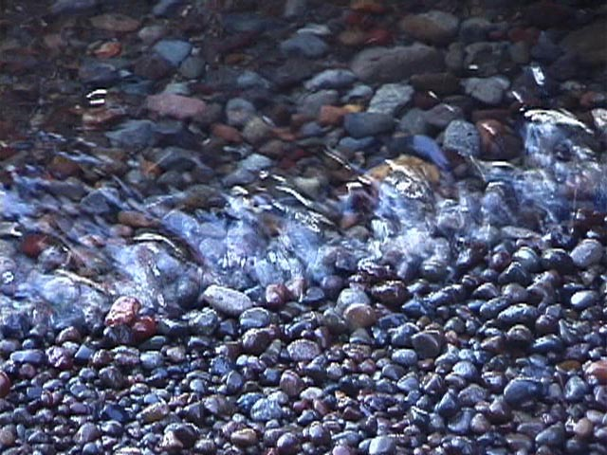
Mechanical - Abrasion
Agents: gravity, running water, and wind
the grinding and wearing away of rock surfaces through the mechanical action of other rock or sand particles

Slide 8
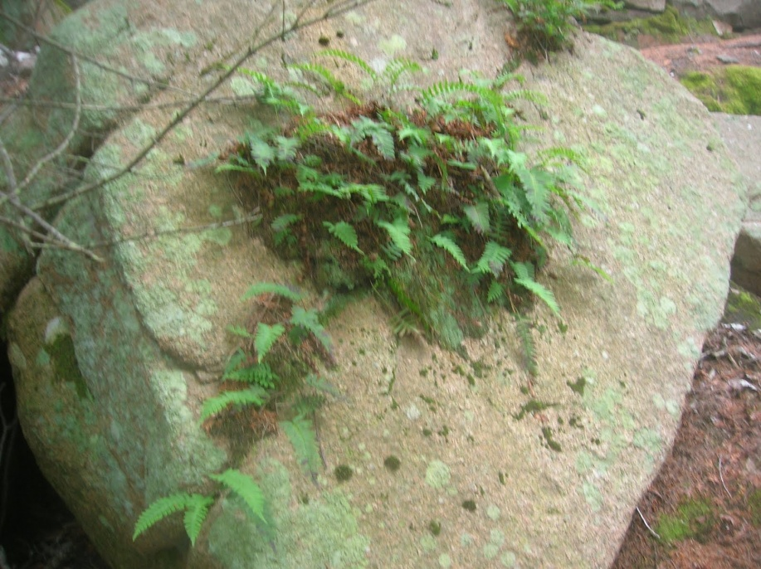
Mechanical - Organic Activity
Agents: plants and animals
As plants grow, the roots grow and expand to create pressure that wedge rock apart.

Slide 9
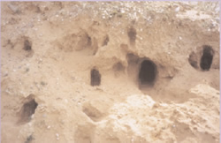
Mechanical - Organic Activity
Animals may burrow through rocks exposing new rock surfaces to weathering agents

Slide 10
Mechanical Weathering
Observe physical weathering

Slide 11
Chemical Weathering
the process by which rocks break down as a result of chemical reactions (even granite can be broken down into sediment)
Chemical reactions commonly occur between rock, water, carbon dioxide, oxygen, acids, and bases.
changes both the composition and physical appearance of the rock.

Slide 12
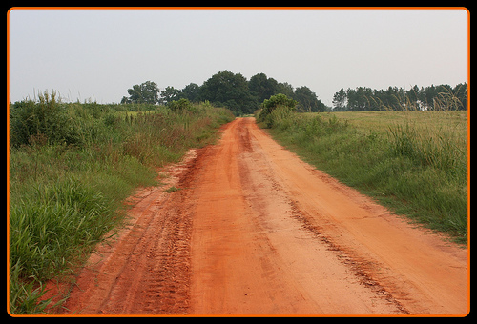
Chemical – Oxidation
the process by which an element combines with oxygen
Oxidation commonly occurs in rock that has iron-bearing minerals, such as hematite and magnetite.

Slide 13
Chemical - Hydrolysis
a chemical reaction between water and another substance to form two or more new substances
Minerals that are affected by hydrolysis often dissolve in water – ex. Feldspars turn to clay
Water can then carry the dissolved minerals to lower layers of rock in a process called leaching.

Slide 14
Chemical - Hydrolysis

Slide 15
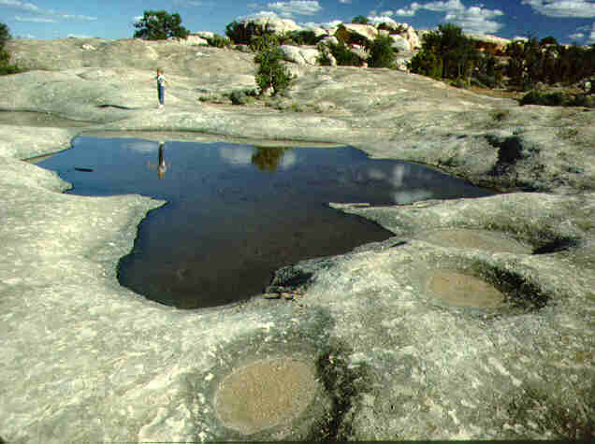
Chemical - Carbonation
the conversion of a compound into a carbonate
Carbonic acid dissolves rocks composed of carbonate minerals

Slide 16
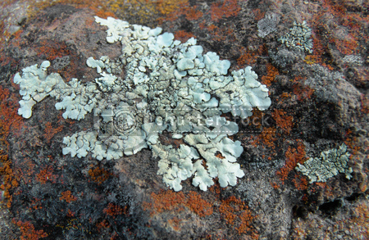
Chemical - Acids
Organic acids - produced naturally by certain living organisms such as lichens or mosses
Acid Precipitation - rain, sleet, or snow, that contains a high concentration of acids, often because of the pollution of the atmosphere (snow on buildings)

Slide 17
Chemical weathering
Chemical weathering of feldspar

Slide 18
Rates of Weathering
The processes of mechanical and chemical weathering generally work very slowly.
The rate at which rock weathers depends on a number of factors, including rock composition, climate, and topography.

Slide 19
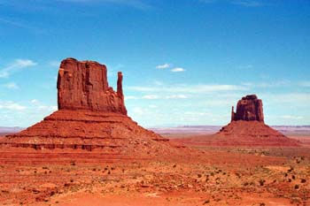
Rates – Rock Composition
differential weathering the process by which softer, less weather resistant rocks wear away at a faster rate than harder, more weather resistant rocks do
For example – sandstone weathers slower than shale, why?

Slide 20
Rates – Surface Area
Surface Area –
The greater the surface area, the faster the weathering

Slide 21
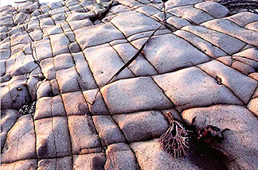
Rates – Surface Area
Fractures and Joints
Most rocks on Earth’s surface contain natural fractures and joints – natural zones of weakness
Fractures and joints increase the surface area of a rock and allow weathering to take place more rapidly.

Slide 22
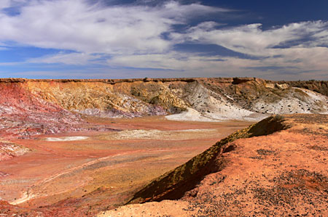
Rates - Climate
In general, climates that have alternating periods of hot and cold weather allow the fastest rates of weathering.
Climates with more moisture result in a faster rate of weathering

Slide 23
Rates - Topography
Because temperatures are generally cold at high elevations, ice wedging is more common at high elevations than at low elevations.
On steep slopes, such as mountainsides, weathered rock fragments are pulled downhill by gravity and washed out by heavy rains.
As a result of the removal of these surface rocks, new surfaces of the mountain are continually exposed to weathering.

Slide 24
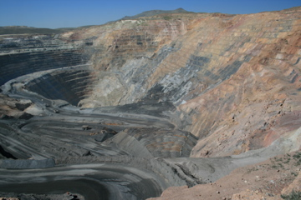
Rates - Human Activity
Mining and construction often expose rock surfaces to agents of weathering such as strong acids.
Recreational activities such as hiking or riding all-terrain vehicles can also speed up weathering

Slide 25
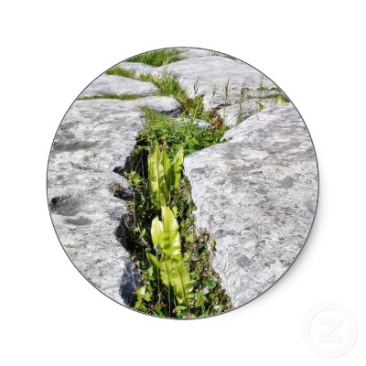
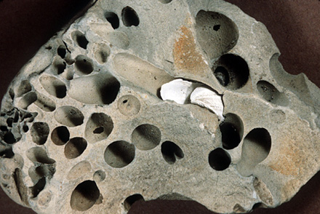
Rates - Plant and Animals
The roots of plants and trees often break apart rock. Burrowing animals dig holes into rock and soil. Both increase the rate of weathering.

Slide 26
Review
Play chemical and physical weathering

