Slide 1
Carbohydrates
1
Notes:
1

Slide 2
Carbohydrates
Main source of energy for all living things
Also used for structure
Known as sugars
Made of Carbon, Hydrogen, & Oxygen
2
Notes:
2

Slide 3
Carbohydrates
Monosaccharide: one sugar unit
Examples: glucose (C₆H₁₂O₆) corn sugar, dextrose
deoxyribose
ribose
Fructose-honey
Galactose-milk sugar
glucose
3
Notes:
3

Slide 4
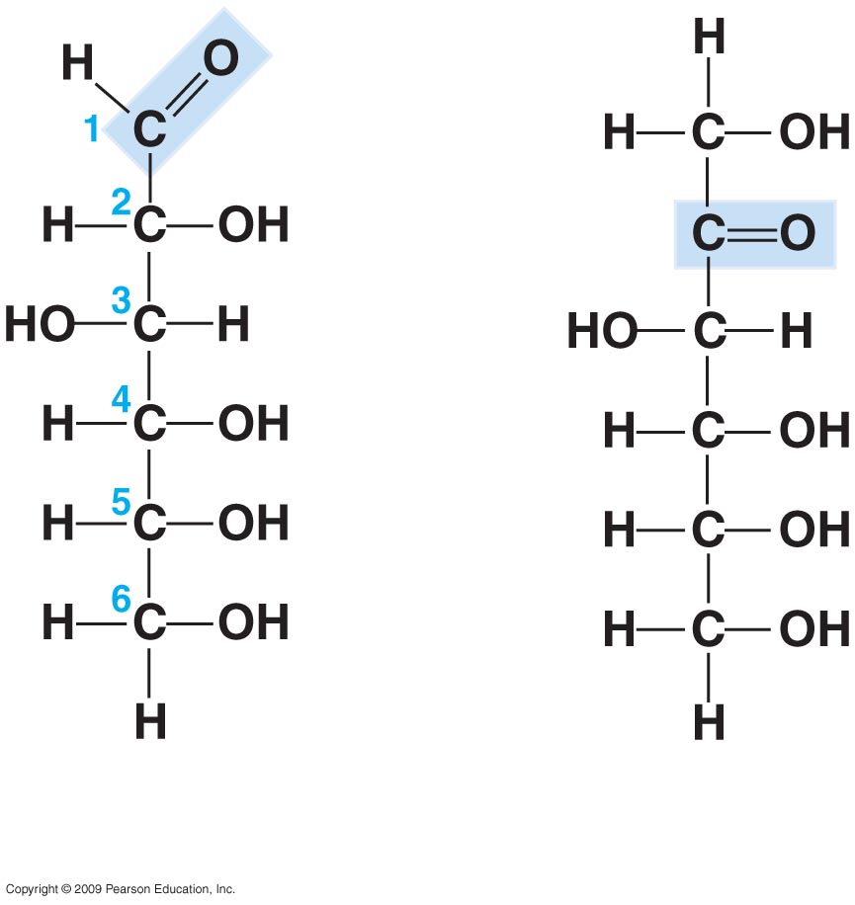
Glucose and Fructose
4

Slide 5
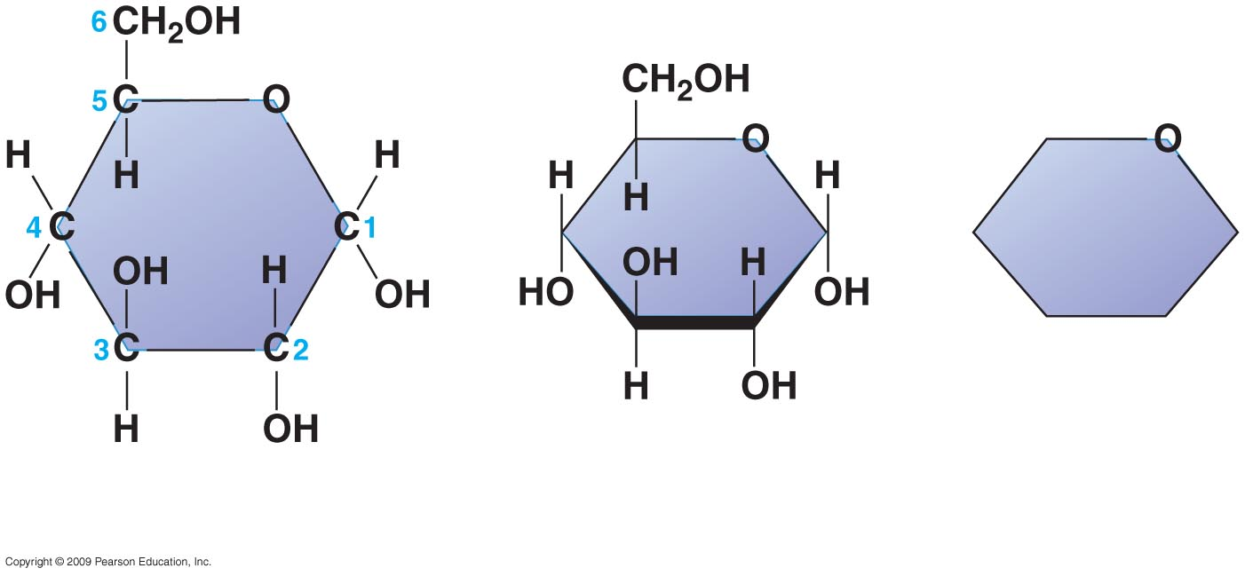
5

Slide 6
Carbohydrates
Disaccharide: two sugar unit
Example:
Sucrose (glucose+fructose)
glucose
fructose
6
Notes:
6

Slide 7
Some important disaccharides in the diet:
Sucrose = glucose + fructose (cane sugar or table sugar; in plant sap)
Lactose = glucose + galactose (found in milk)
Maltose = glucose + glucose (malt sugar- germinating seeds and making beer)
7

Slide 8
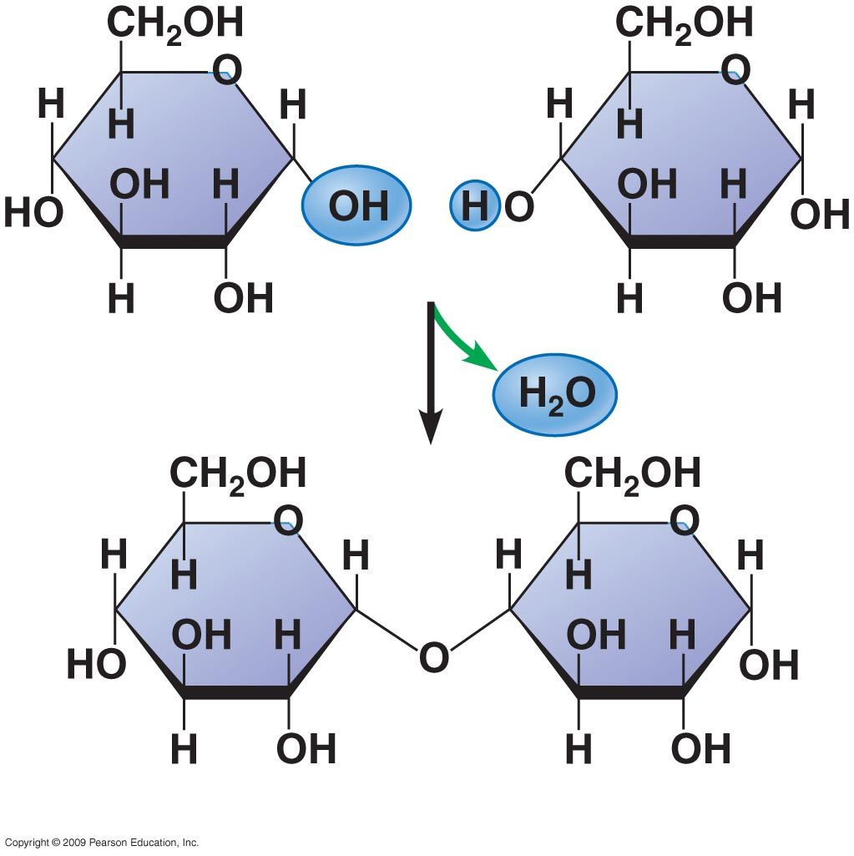
Glucose+Glucose=Maltose
8

Slide 9
Carbohydrates
Polysaccharide: many sugar units
Examples: starch (bread, potatoes)
glycogen (beef muscle)
cellulose (lettuce,corn)
glucose
glucose
glucose
glucose
cellulose
glucose
glucose
glucose
glucose
9
Notes:
9

Slide 10
Because they are large, insoluble molecules, they are ideal for storage products.
Because of their large size, they lack the sweetness of the simple and double sugars.
10

Slide 11
Starch
11

Slide 12
Starch
We ingest starch in the form of “starchy” foods, such as grain products and root vegetables --carrots, potatoes, wheat, corn and rice.
Starch is then broken down by the body into individual glucose molecules to be used for energy.
If not needed for energy, the body then stores the excess glucose as glycogen.
12

Slide 13
Glycogen
Animals store excess sugar in the form of glycogen
Glycogen is stored in granules in our liver and muscle cells, which hydrolyze the glycogen to release glucose when it is needed.
13

Slide 14
Glycogen
14

Slide 15
Many polysaccharides serve as building materials for structures that protect cells and support whole organisms.
Cellulose, the most abundant organic compound on earth, forms cable-like fibrils in the tough walls that enclose plant cells and is a major component of wood.
Cellulose resembles starch and glycogen in being a polymer of glucose, but its glucose monomers form an unbranched rod, rather than a coil.
15

Slide 16
Cellulose
16

Slide 17
17

Slide 18
Unlike the glucose linkages in starch and glycogen, those in cellulose cannot be hydrolyzed by most animals.
The cellulose in plant foods that passes unchanged through our digestive tract is commonly known as fiber.
18

Slide 19
Chitin
used by insects and crustaceans to build their exoskeleton
-also found in cell wall of fungi
19

Slide 20
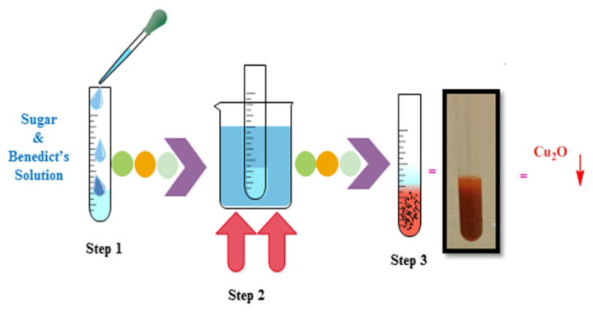
Benedict’s Test for Sugars

Slide 21
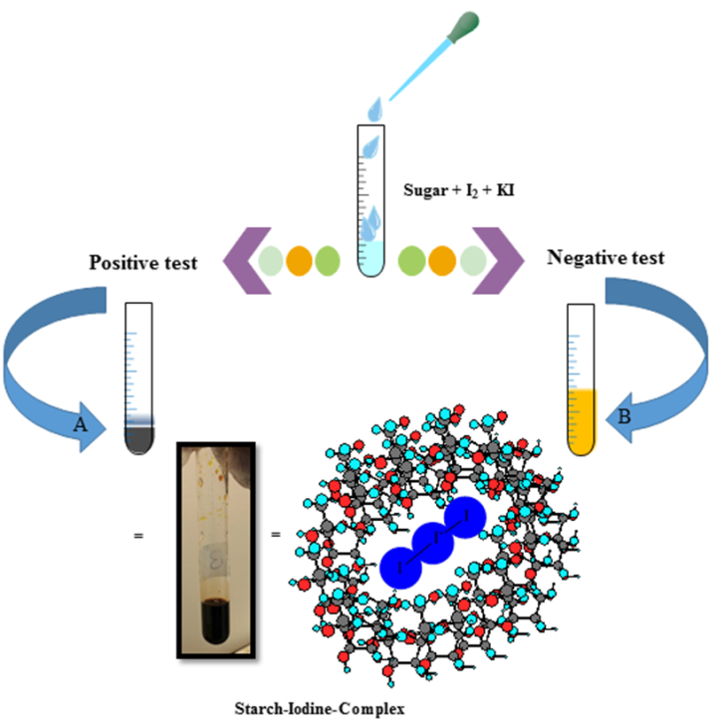
Lugol’s Test for Starches

