Slide 1
GA’s seven wonders
Play

Slide 2
Amicalola Falls
At 729 feet, Amicalola Falls, near Dawsonville, are the highest waterfalls in Georgia. The name “Amicalola” is a Cherokee word meaning “tumbling waters.” The falls are part of Amicalola Falls State Park, which includes an eight-mile trail that links the falls to the southernmost point of the Appalachian Trail Play

Slide 3
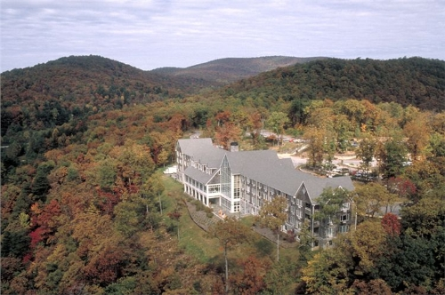

Slide 4
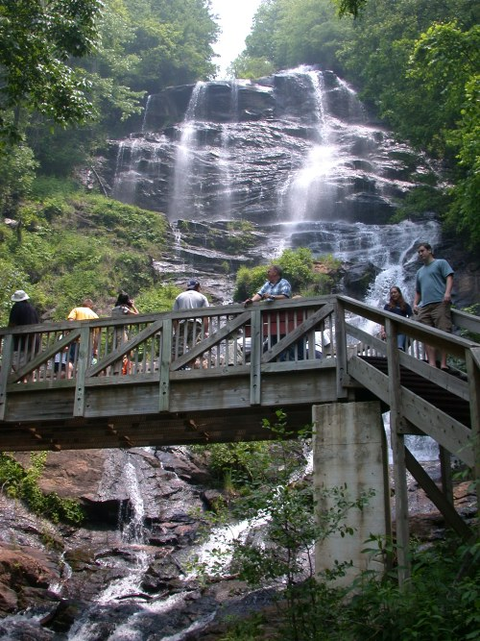
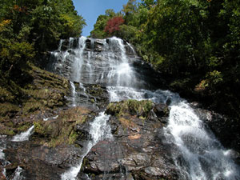

Slide 5
Okefenokee Swamp
The Okefenokee Swamp covers about 700 square miles of southeastern Georgia. Okefenokee means “land of the trembling earth” in Seminole, which refers to the swamp’s spongy bogs. The wildlife refuge is home to a variety of plant and animal wildlife.

Slide 6
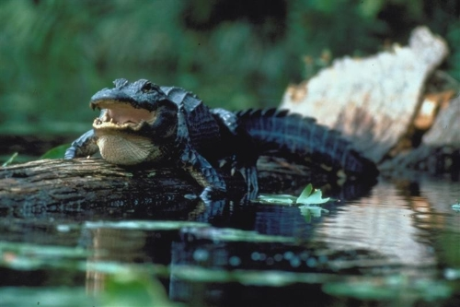

Slide 7
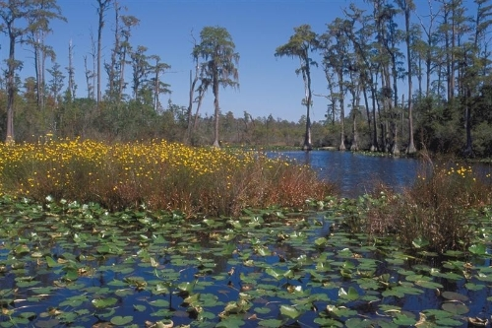

Slide 8
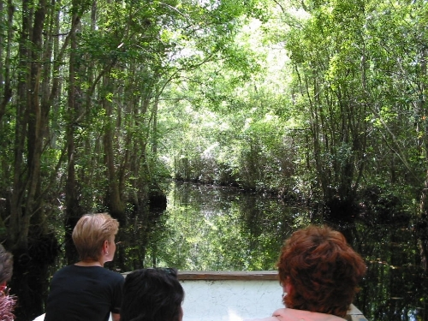

Slide 9
Providence Canyon
Known as “Georgia’s Little Grand Canyon,” Providence Canyon is located near Lumpkin. Over the past 150 years, human activity and poor farming practices have led to the massive erosion that created these 150 foot deep canyons and gorges
Play

Slide 10
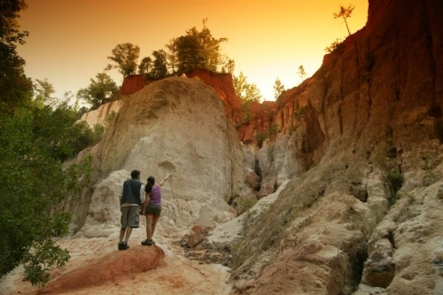

Slide 11
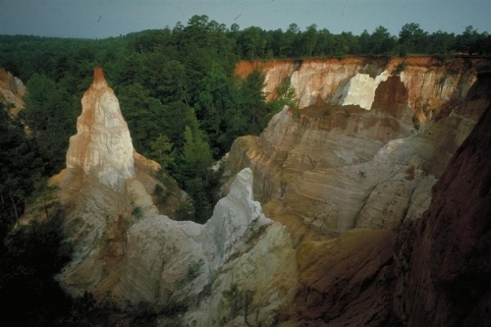

Slide 12
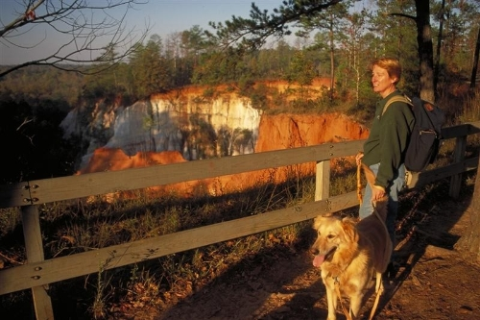

Slide 13
Stone Mountain
Known for its size and carving, Stone Mountain is the world’s largest piece of exposed granite, at 825 feet high and 5 miles around. The carving (bigger than three football fields) depicts Confederate President Jefferson Davis, General Robert E. Lee and Lt. General Thomas “Stonewall” Jackson, all major players in the Civil War.
Play

Slide 14
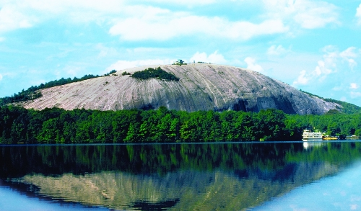

Slide 16
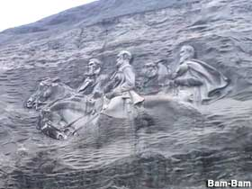
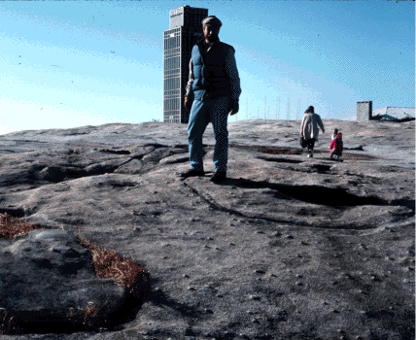

Slide 17
Tallulah Gorge
Tallulah Gorge Tallulah Gorge was created by a series of waterfalls that were dammed by Georgia Power in 1912. The gorge was once thought to house evil spirits, and the Native Americans named it Tallulah, which means “terrible.” Play

Slide 18
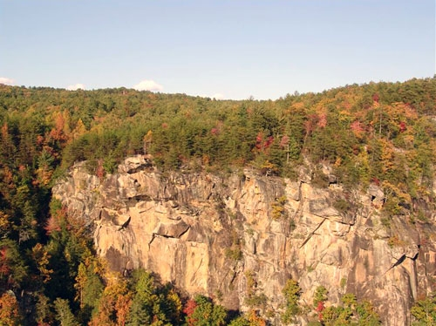

Slide 19
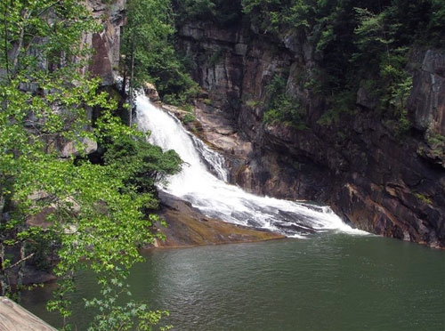

Slide 20
Warm Springs
Warm Springs A favorite spot of former U.S. president Franklin D. Roosevelt, Warm Springs is located in west Georgia. The area’s springs are 88 degrees year-round. Their waters helped President Roosevelt as he dealt with polio, a common illness during his lifetime.
Play

Slide 21
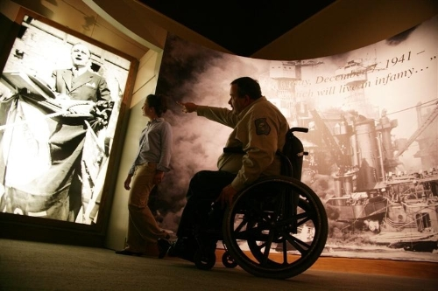

Slide 22
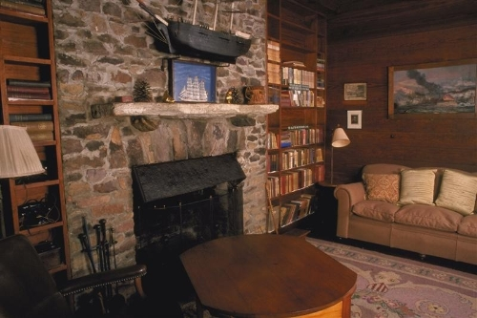

Slide 23
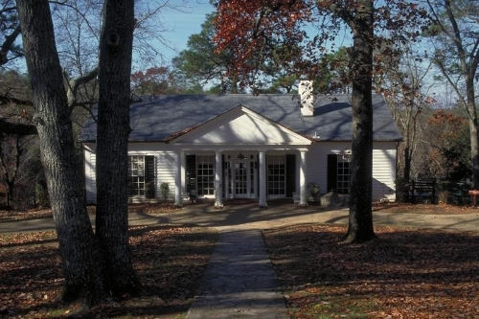

Slide 24
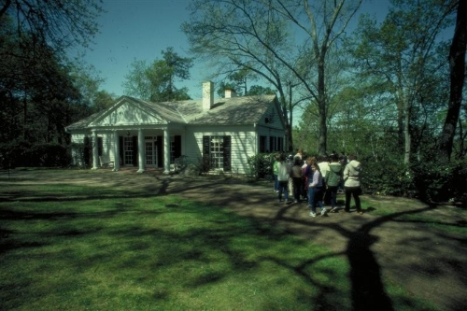

Slide 25
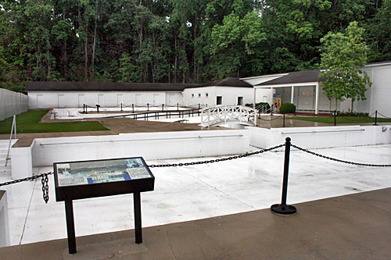

Slide 26
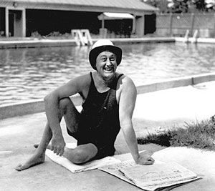
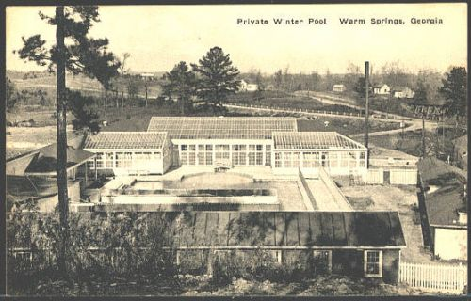

Slide 27
Radium Springs, GA
Radium Springs is an unincorporated community located on the southeast outskirts of Albany in Dougherty County, Georgia, United States. It is part of the Albany, Georgia Metropolitan Statistical Area.
Radium Springs is best known as the location of one of the "Seven Natural Wonders of Georgia": the largest natural spring in the state. The deep blue waters of Radium Springs flow at 70,000 gallons (265,000 liters) per minute and empty into the Flint River. There is also an extensive underwater cavern system.
The water contains trace sources of radium and the temperature is 68 degrees Fahrenheit (20 degrees Celsius) year round.
Play Caves

Slide 28
Radium Springs, GA
Prior to the discovery of radium in the water in 1925, the site was known as "Blue Springs".
A casino was built overlooking the springs in the 1920s and Radium Springs was a popular spa and resort. Northerners on their way by train to spend winter in Florida often stopped to swim in the springs, which was thought to be healthful because of the radium element. The casino was severely damaged when the river flooded in 1994, and again in 1998, and was demolished in 2003.
The nearby Radium Country Club and Golf Course has been refurbished. The course was originally designed in 1927 by noted golf course architect John Law Kerr.
Play

Slide 29
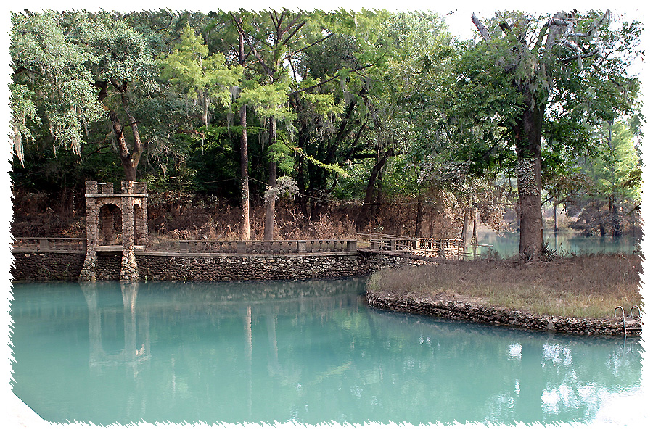

Slide 30
