Slide 1
The Human Genome

Slide 2
HUMAN GENETICS
Dominant and Recessive
Homozygous/Heterozygous
work for human genes too!

Slide 3
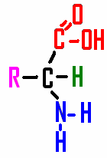
REMEMBER YOUR MOLECULES!
Proteins
________ are made by joining
___________ subunits together
amino acid

Slide 4
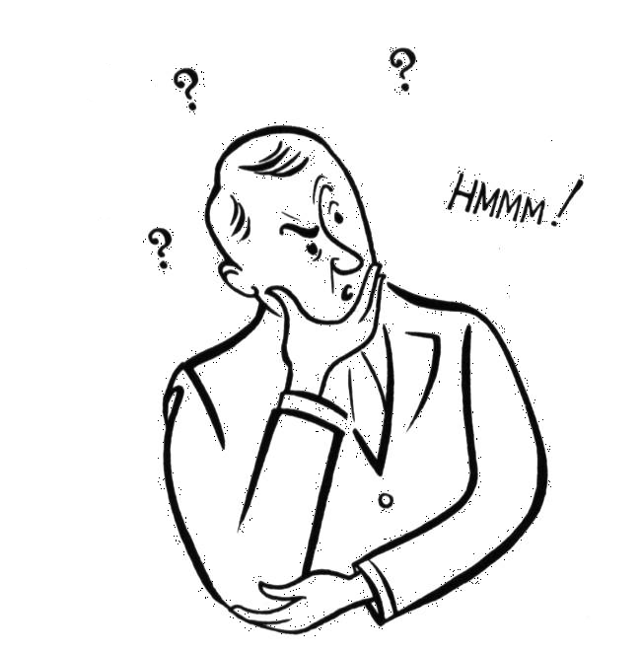
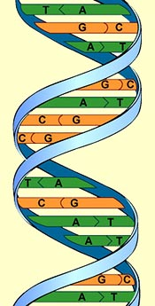
REMEMBER YOUR MOLECULES
__________ is carried
in the ________ of
A, T, G, C’s on a
_____ molecule
Genetic code
sequence
DNA

Slide 5
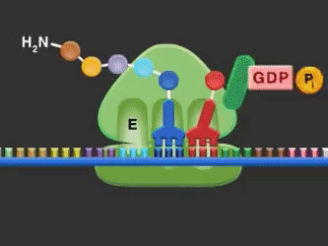
The sequence of A’s, T’s, G’s & C’s
tells the _______ of ________ in the ________.
ORDER
amino acids
protein

Slide 6
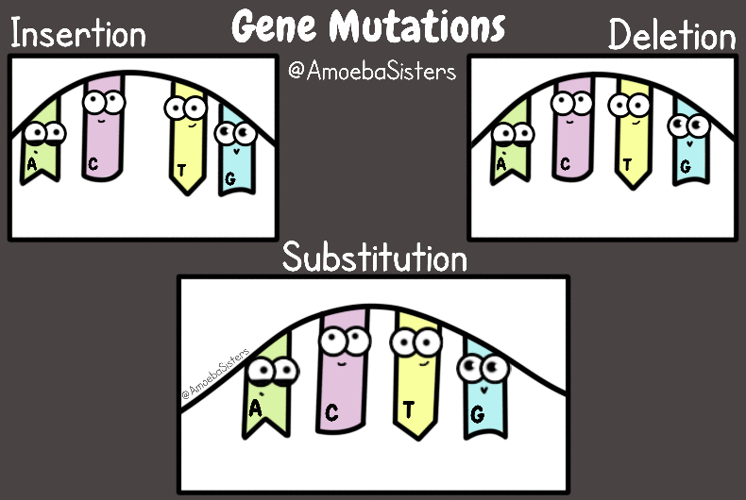
Changes in the gene code _______________ that is made
A change in the genetic code =
________________
change the protein
MUTATION

Slide 8
KINDS OF MUTATIONS
BODY
SOMATIC
________ CELLS = ___________ CELLS
Somatic cell mutations can: ______________________
______________________
_____________
Cause cancer
Make cell not able to function
Kill cell
WON’T BE
BUT _________ passed on to offspring

Slide 9
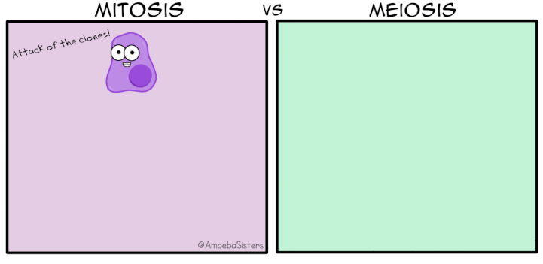
Kinds of Mutations
___________ = Germ cells
(sperm & eggs)
GAMETES
CAN BE
Germ cell mutations ________ passed on to offspring
http://anthro.palomar.edu/biobasis/images/meiosis.gif

Slide 10
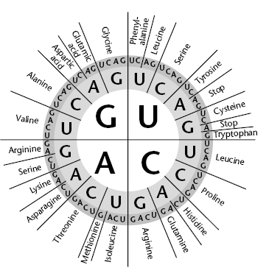
MUTATIONS can be:
NEUTRAL
____________- Most mutations have little or no effect on gene ____________.
_____________ in
code can absorb
many mutations
without changing the
amino acid sequence.
UUC and UUU both
code for same amino acid
function
REDUNDANCY

Slide 11
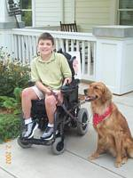
MUTATIONS can be:
HARMFUL
____________ - Mutations that produce ______________ are usually harmful.
Harmful mutations are associated with many
________________ and can cause
____________
defective proteins
genetic disorders
cancer

Slide 12
MUTATIONS can be:
____________ - Some mutations
change proteins that are so vital to life that they cause death, usually before birth.
50% of pregnancies that
abort spontaneously have
genetic abnormalities
LETHAL
http://www.global-warming-and-the-climate.com/images/tombstone-RIP.gif

Slide 13
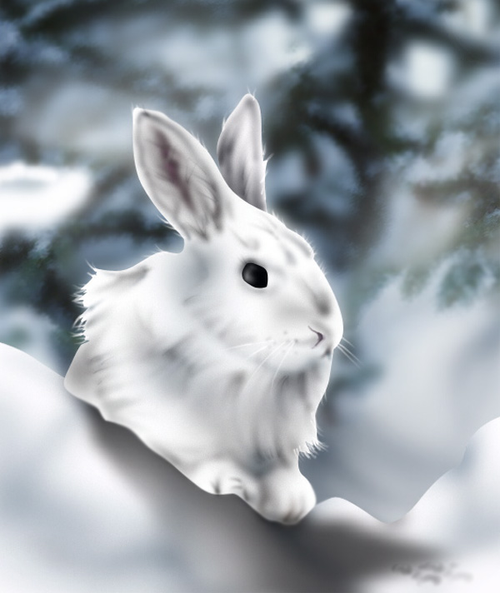
MUTATIONS can be:
BENEFICIAL
____________- Mutations are also a source of ______________ in the
population
genetic variation
MORE ON THIS in 2 weeks
Mutations can help an
organism
_________________
Provide a way for species to change over time
survive and reproduce

Slide 14
REMEMBER!
_______________ are changes in the genetic material.
MUTATIONS
Mutations can happen:
when cells make_________ in copying DNA
when cells are exposed to environmental ___________ like __________- X-rays, tanning booths
__________ - cigarette smoke, pollutants
__________ - HPV
mistakes
carcinogens
radiation
chemicals
viruses

Slide 15
Images from: http://www.bbc.co.uk/scotland/education/bitesize/higher/img/biology/genetics_adaptation/mutations/02gene_mutation.gif
KINDS OF MUTATIONS
Mutations that produce changes
in a single gene =
_________________
Mutations that produce changes
in whole chromosomes = _____________________
GENE MUTATIONS
CHROMOSOMAL MUTATIONS

Slide 16
A mutation that causes a protein to be
NON-FUNCTIONAL would appear
_______________ to the normal working allele.
Examples of __________________________ GENETIC DISORDERS:
____________________
____________________
____________________
RECESSIVE
AUTOSOMAL RECESSIVE
PHENYLKETONURIA (PKU)
TAY-SACHS DISEASE
CYSTIC FIBROSIS

Slide 17
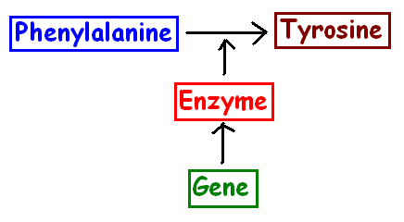
Phenylketonuria (PKU)
CAUSE: Mutation in gene for an ___________ that __________ an ___________ called phenylalanine
Build up causes ________________________
ENZYME
breaks down
amino acid
X
X
MENTAL RETARDATION
http://biology.clc.uc.edu/courses/bio104/protein.htm

Slide 18
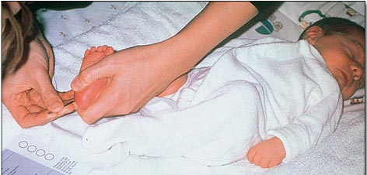
Phenylketonuria (PKU)
ALL
tested
____ babies are ________
for PKU before they
leave the hospital.
Treatment: Need a diet _____________________ to extend life and ______________ mental retardation
If phenylalanine is an _____________,
what type of foods should PKU patients avoid? __________________
http://labspace.open.ac.uk/file.php/2588/SK195_6_002i.jpg
LOW in phenylalanine
PREVENT
amino acid
PROTEINS !

Slide 19
THINK ABOUT IT
What does a can of
Diet Coke have to do
with human genetics?
LOOK AT THE WARNING LABEL !
NUTRASWEET
______________ is made with phenylalanine

Slide 20
TAY-SACHS DISEASE ___________________
AUTOSOMAL RECESSIVE
CAUSE: Mutation in gene for an ___________ that breaks down a kind of _________in the developing _________
Build up of lipids in brain cells leads to: mental retardation, blindness, and DEATH in early childhood
ENZYME
LIPID
BRAIN
Found more frequently in people with _______ _____________ ______________, ancestry
Jewish
Mediterranean
Middle Eastern
Image from: http://www.djsfoundation.org/images/Steeler%20pics%20Dylan.jpg

Slide 21
CYSTIC FIBROSIS
CAUSE: Loss of 3 DNA bases in a gene for the _____________ that transports _________ so salt balance is upset
Causes a build up of _________________ in lungs and digestive organs
.
protein
Cl⁻ ions
thick mucous
Image from: BIOLOGY by Miller and Levine; Prentice Hall Publishing ©2006

Slide 22
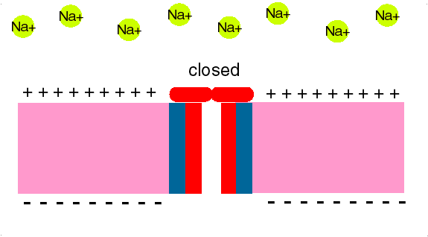
REMEMBER TRANSPORT
_____________ are membrane proteins that make _________ through the bilayer for ____ to pass through (Na⁺, K⁺, Ca⁺⁺, Cl⁻)
ION CHANNELS
tunnels
ions

Slide 23
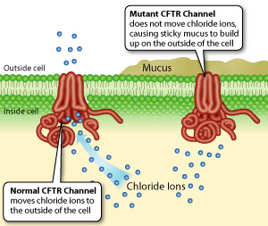
CYSTIC FIBROSIS
http://learn.genetics.utah.edu/content/disorders/whataregd/cf/index.html

Slide 24
CYSTIC FIBROSIS
Leads to:
_________ and _________ complications, increased susceptibility to infections;
“__________” is a symptom
More common in ____________ but can affect all races.
30,000 people in U.S. have cystic fibrosis
1 in 31 people are carriers
respiratory
digestive
Salty skin
Caucasians

Slide 25
A mutation that codes for a new protein
whose action masks the normal allele
appears as a ______________ mutation.
Examples of _________________________ GENETIC DISORDERS:
____________________
____________________
DOMINANT
AUTOSOMAL DOMINANT
Huntington’s disease
Achondroplasia

Slide 26
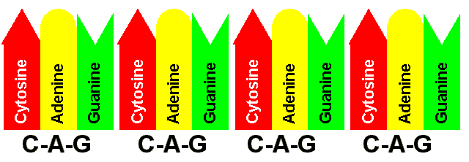
HUNTINGTON’S DISEASE ______________________
AUTOSOMAL DOMINANT
CAUSE: Extra 40-100 ______________ at end of gene on chromosome 4
The _____________ . . . the more __________ the symptoms.
CAG repeats
more repeats
severe
http://www.healthsystem.virginia.edu/internet/huntdisease/images/cag.gif

Slide 27
HUNTINGTON’S DISEASE
Huntington’s brain
Causes progressive _____ of ________________ and ___________function
loss
muscle control
mental
1 in 10,000 people in U.S.
have Huntington’s disease
Normal brain
http://www.scielo.br/img/revistas/bjmbr/v39n8/html/6233i01.htm

Slide 28
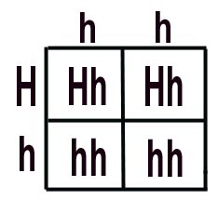
A person with
Huntington’s disease
has a _____ chance of
passing the disorder on to
their offspring.
50%
Problem: Symptoms of disorder usually don’t show until ____________ . . .
so you don’t know you have it until ________ you have had children.
MIDDLE AGE
AFTER

Slide 29
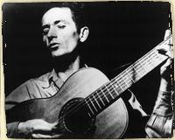
THINK ABOUT IT
What does the song
have to do with
human genetics?
“This Land is My Land” was written by a musician named Woody Guthrie before he began to show the symptoms of Huntington’s disease.
Click to hear
Woody’s song

Slide 30
Woody Guthrie had a son named Arlo that was a popular musician during the 70’s
Click to hear one
of Arlo’s songs
Before 1993 there was no test for Huntington’s.
If one of your parents showed symptoms, you had to wait to see if it had been passed on to you.

Slide 31
http://www.jimdirden.com/woodyfest2004/artists/index_3.htm
Arlo Guthrie is still performing today.
He never developed symptoms for Huntington’s disease.
If there is no cure, would YOU want to be tested and find out if you have the gene?
http://webs.wichita.edu/depttools/depttoolsmemberfiles/accomp/question_mark%20(WinCE).jpg

Slide 32
ACHONDROPLASIA (One kind of Dwarfism)
AUTOSOMAL DOMINANT
CAUSE: ___________________________ gene
1 in 20,000 births
200,000 “little people” worldwide
One of oldest known disorders – seen in Egyptian art

Slide 33
ACHONDROPLASIA (One kind of Dwarfism)
Normal size head and torso; short arms and legs
Problem with way cartilage changes to bone as bones grow

Slide 34
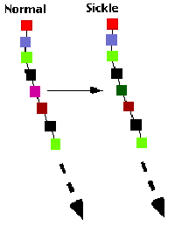
DISORDERS CAUSED
BY ____________________
____________________
AUTOSOMAL Recessive ALLELES
SICKLE CELL DISEASE
CAUSE: T changed to A in gene for
__________________
(protein in red blood cells
that carries oxygen in blood)
HEMOGLOBIN

Slide 35
SICKLE CELL DISEASE
Play
SYMPTOMS:
_____________ become sickle shaped in persons with ______
sickle cell ________
RED BLOOD CELLS
TWO
ALLELES

Slide 36
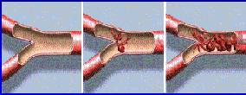
SICKLE CELL DISEASE
Circulatory problems
Cells stick in capillaries
Loss of blood cells (anemia)
Organ damage (brain, heart, spleen)
Can lead to DEATH

Slide 37
SICKLE CELL DISEASE
AFRICAN AMERICANS
More common in _________________
1 in 500 = have sickle cell disease
1 in 10 = carriers for allele
Also affects persons of _______________ and _________________ descent
Why do so many African Americans carry the sickle cell allele?
MEDITERRANEAN
MIDDLE EASTERN

Slide 38
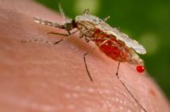
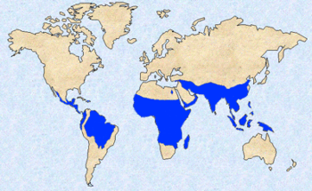
SICKLE CELL DISEASE
Many can trace their ancestry to west
central Africa where ___________,
a serious parasitic disease that
infects red blood cells is common.
MALARIA
Watch a video about
sickle cell and malaria
Images from: http://en.wikipedia.org/wiki/Malaria

Slide 39
HOMOZYGOUS
A person who is __________________ for the ____________allele (ss) will have _______________
A person who is _________________ for normal hemoglobin alleles will have normal blood cells, but can become infected with __________ (SS)
A _________________ person (Ss)
(with one normal/one sickle cell allele) is
generally healthy and has the benefit of
being _________ to malaria
sickle cell
sickle disease
HOMOZYGOUS
malaria
HETEROZYGOUS
resistant

Slide 40
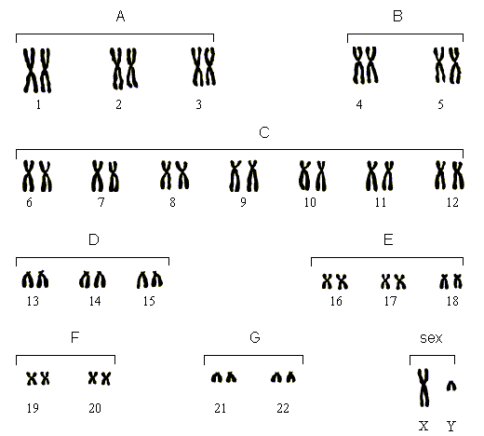
KARYOTYPE
A __________ is a picture of an organism’s chromosomes

Slide 41
Chromosomes that determine the sex of an organism = _________________
All other chromosomes = _________________
http://www.angelbabygifts.com/
Sex chromosomes
autosomes
Humans have two sex chromosomes
and _____ autosomes
X
y
44

Slide 42
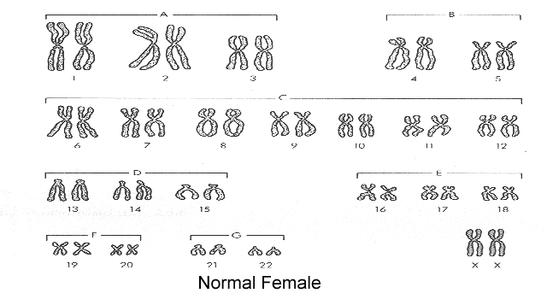
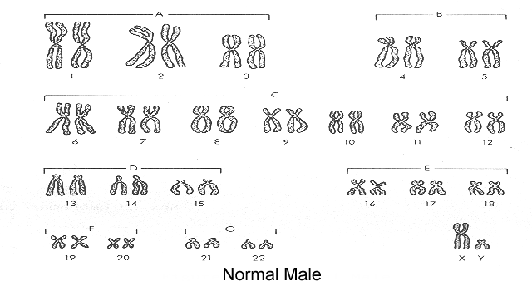
SEX DETERMINATION
XX =
female
male
Xy =

Slide 43
SEX CHROMOSOMES CAN CARRY OTHER GENES TOO = ___________________
SEX LINKED TRAITS
These traits show up in different
_______________ in males and females
because they move with the sex chromosomes
percentages

Slide 44
Y-LINKED GENES:
Genes ______________ chromosome
carried on Y
EXAMPLE: Hairy pinna
Y linked
ONLY
in males
_________genes _____ show up _______

Slide 45
X-LINKED
____________ GENES:
are carried on the X chromosome
X-linked recessive disorders
show up _____________
in ______ than females
because males only have
______ X chromosome.
MORE frequently
MALES
ONE

Slide 46
Males ONLY HAVE ONE X
DEFECTIVE
NORMAL
They either
have the
disorder
Or
They are
normal

Slide 47
FEMALES HAVE TWO X CHROMOSOMES
DEFECTIVE
NORMAL
DEFECTIVE
Females have one normal gene that works.
Females __________ defective recessive
alleles to show the
disorder
need 2

Slide 48
X-LINKED RECESSIVE
Examples of ________________________ DISORDERS:
____________________
____________________
____________________
HEMOPHILIA
COLORBLINDNESS
DUCHENNE MUSCULAR DYSTROPHY

Slide 49
HEMOPHILIA
CAUSE: Mutation in genes for __________________ carried ______ chromosome
Blood clotting proteins are missing so person with this disorder can’t stop bleeding when injured; can ________________ from minor cuts or suffer internal bleeding
from bruises or bumps.
Blood clotting proteins
on X
bleed to death

Slide 50
HEMOPHILIA
Treatment:
Need ____________ of normal clotting proteins to stop bleeding
_____________ in ______ because it is
X-linked, but females with ______ recessive hemophilia alleles will also show the trait.
1 in 10,000 males has hemophilia
injections
More common
males
TWO

Slide 51
COLORBLINDNESS
CAUSE: Mutation in one of three genes for _______________ carried on X chromosome
Persons with this disorder have trouble distinguishing colors.
_________________
colorblindness is most common
Seen in 1 in 10 males
1 in 100 females
Color vision
Red-green
http://gizmodo.com/gadgets/peripherals/samsung-develops-lcd-for-colorblind-036306.php

Slide 52
Duchenne Muscular Dystrophy
CAUSE:
deletion in gene
that codes for a
_______________
Results in
____________________
and loss of ___________________
muscle protein
progressive weakening
skeletal muscle
http://www.cadenhead.org/workbench/gems/jerry-lewis-telethon.jpg
http://www.tokyo-med.ac.jp/genet/chm/dei.gif

Slide 53
Duchenne Muscular Dystrophy (DMD)
SYMPTOMS:
1 in 3000 male births
Appears before age 5
Progressive muscle weakening
Most in wheelchair by age 13
Eventually lethal
Play

Slide 54
What’s the pattern:
________ traits show up _______ in _______
__________________ traits:
______________________ than females.
________________ can be ________.
_______________________ traits:
BOTH ______ & _________ can be ________
Y-linked ONLY males
X-linked recessive
more common in males
ONLY FEMALES carriers
AUTOSOMAL RECESSIVE
MALES FEMALES carriers

Slide 55
________________ Abnormalities
CHROMOSOMAL
1 infant in 200 newborns has a chromosomal abnormality
28% of first trimester miscarriages have a chromosomal abnormality
Abnormalities in larger chromosomes don’t usually survive

Slide 56
CHROMOSOMAL MUTATIONS
____________________________:
Change in the ______________ or
____________ of chromosomes
structure
number

Slide 57
Homologous chromosomes ________________ during MEIOSIS
= _________________________
One cell gets 2 copies of
the chromosome the
other cell gets none.
fail to separate
NONDISJUNCTION

Slide 58
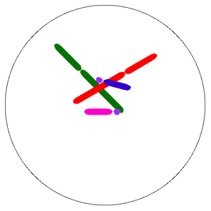
Normal Meiosis
Nondisjunction
http://web.udl.es/usuaris/e4650869/docencia/gen_etica/meioferti2.html
http://www.tokyo-med.ac.jp/genet/anm/domov.gif

Slide 59
Nondisjunction

Slide 60
Nondisjunction
Since it happens to a
sperm or egg, the new
baby can end up
with _____________ of a
chromosome
= __________________
OR
only ___________ of a
chromosome
= ___________________
3 copies
TRISOMY
one copy
MONOSOMY

Slide 61
Human Abnormalities caused by Non-Disjunction __________________ __________________ __________________
Down syndrome
Klinefelter syndrome
Turner syndrome

Slide 62
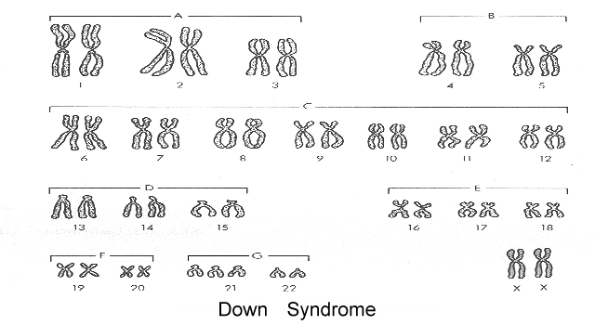
Down syndrome (= ____________)
TRISOMY 21

Slide 63
Down syndrome (Trisomy 21)
1 in 800 births
Similar facial features
Slanted eyes
Protruding tongue

Slide 64
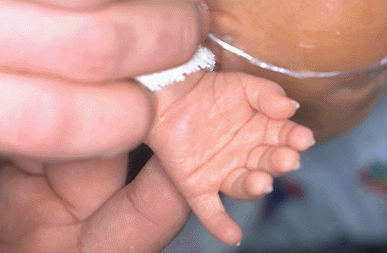
Down syndrome (Trisomy 21)
Simian line on palm

Slide 65
Down syndrome (Trisomy 21)
Most common chromosomal abnormality
50% have heart defects that need surgery to repair
Mild to severe mental retardation
Increases susceptibility to many diseases
Risk of having a child with Down syndrome increases with age of mom

Slide 66
Down syndrome (Trisomy 21)
Risk of having a child with Down syndrome related to age of mom
More common in women UNDER 16 or OVER 35
Cells that make eggs start meiosis in embryo
Stop in PROPHASE I (synapsis) One egg restarts & finishs division each month So an egg released at age 40 has been in synapsis for 40 years . . . chromosomes more likely to “stick”

Slide 67
Turner syndrome

Slide 68
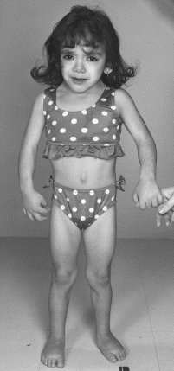
Turner syndrome ____
XO
1 in 5000 births
Females have only one X chromosome
Small size
Slightly decreased intelligence
35% have heart abnormalities
Hearing loss common
Broad chest
Reproductive organs don’t develop at puberty
Can’t have children
http://medgen.genetics.utah.edu/photographs/diseases/high/611.gif

Slide 69
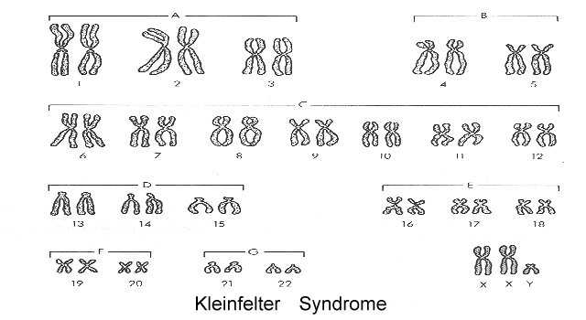
Klinefelter syndrome XXy

Slide 70
Klinefelter syndrome
1 in 1000 births
Males have extra X chromosomes
(Can be XXy, XXXy, or XXXXy)
Average to slight decrease in intelligence
Small testes/can’t have children
Usually not discovered until puberty when don’t mature like peers

Slide 71
X-chromosome Inactivation
ONE X
In female cells ______ chromosome is randomly ________________
It condenses and forms a dense region in the nucleus called a
_____________
SWITCHED OFF
BARR BODY
http://fig.cox.miami.edu/~cmallery/150/gene/barr.htm

Slide 72
CAT COLOR
http://www.islandstrolling.com/mainland/peloponnes/photo/mystra_cat_white_orange_black.jpg
In cats, a gene that
controls the _____________
is carried on the
____________________
SPOT COLOR
X chromosome
In some female cells the X with the allele for orange spots
is switched off and in some cells the X with the allele for
black spots is switched off, so cat has different
colored spots.
See a video

Slide 73
CAT COLOR
http://ascensionparish.net/forum/messages/14/2493.jpg
_________ cats have only
one X chromosome, so they
can only have
____________ of spots!
Male
one color
THINK ABOUT IT?
How many colors of spots could a male cat with
Klinefelter syndrome have?

