Slide 1
Caverns, Sinkholes and Karst

Slide 2
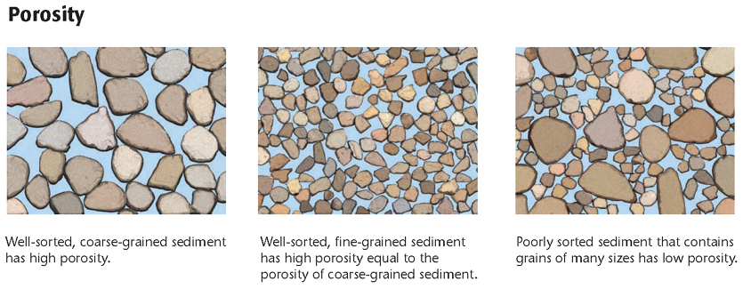
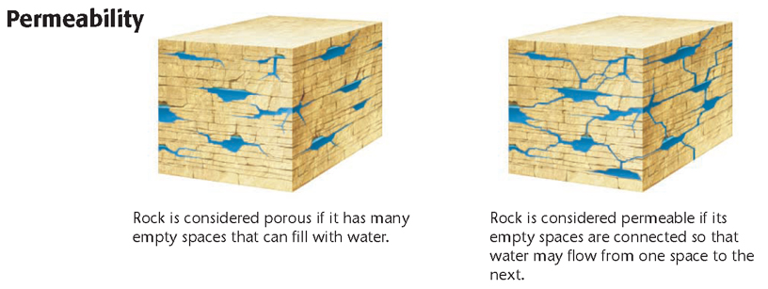
groundwater the water that is beneath Earth’s surface
porosity the percentage of the total volume of a rock or sediment that consists of open spaces
permeability the ability of a rock or sediment to let fluids pass through its open spaces, or pores

Slide 3
Groundwater and Chemical Weathering
As groundwater passes through permeable rock, minerals in the rock dissolve. The warmer the rock is and the longer it is in contact with water, the greater the amount of dissolved minerals in the water.
Water that contains relatively high concentrations of dissolved minerals, especially minerals rich in calcium, magnesium, and iron, is called hard water.
Water that contains relatively low concentrations of dissolved minerals is called soft water

Slide 4
Results of Weathering by Groundwater
One way that minerals become dissolved in groundwater is through chemical weathering.
As water moves through soil and other organic materials, the water combines with carbon dioxide to form carbonic acid.
This weak acid chemically weathers the rock that the acid passes through by breaking down and dissolving the minerals in the rock.

Slide 5
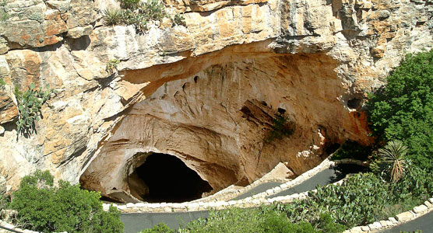
Caverns
cavern a natural cavity that forms in rocks as a result of the dissolution of minerals; also a large cave that commonly contains many smaller, connecting chambers

Slide 6
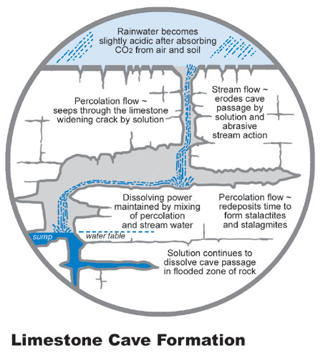
Rocks that are rich in the mineral calcite, such as limestone, are especially vulnerable to chemical weathering.
Although limestone is not porous, vertical and horizontal cracks commonly occur through limestone layers.
As groundwater flows through these cracks, carbonic acid slowly dissolves the limestone and enlarges the cracks.

Slide 7
Stalactites and Stalagmites
When water containing dissolved calcite drips from the ceiling of a limestone cavern, some of the calcite is deposited on the ceiling.
As this calcite builds up, it forms a suspended, cone-shaped deposit called a stalactite.
When drops of water fall on the cavern floor, calcite builds up to form an upward-pointing cone called a stalagmite.
Remember – stalactites hold tight to the ceiling while stalagmites might reach the ceiling

Slide 8
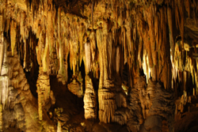
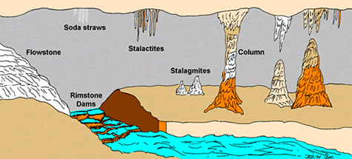

Slide 9
How caves are made?
Animation of cave formation

Slide 10
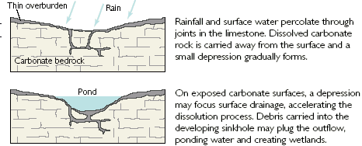
Sinkholes
sinkhole a circular depression that forms when rock dissolves, when overlying sediment fills an existing cavity, or when the roof of an underground cavern or mine collapses

Slide 11
Subsidence sinkholes form by a similar process except that as rock dissolves, overlying sediments settle into cracks in the rock and a depression forms.
Tend to develop gradually where cover sediments are permeable and contain sand

Slide 12
Collapse sinkholes may form when sediment below the surface is removed and an empty space forms within the sediment layer.
Cover sediment consists of a large amount of clay
Collapse sinkholes may also form during dry periods, when the water table is low and caverns are not completely filled with water.
Collapse sinkholes may develop abruptly and cause extensive damage.

Slide 13
Sinkhole
Sinkhole News

Slide 15
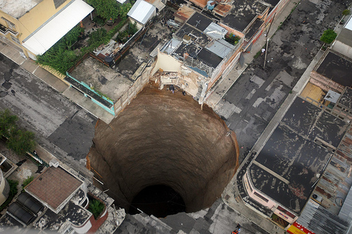

Slide 16
The 2010 Guatemala City sinkhole was a disaster in which an area approximately 65 ft (20 m) across and 100 ft (30 m) deep collapsed in Guatemala City's Zona 2, swallowing a three-story factory.The sinkhole occurred for a combination of reasons, including Tropical Storm Agatha, the Pacaya Volcano eruption, and leakage from sewer pipes.

Slide 17
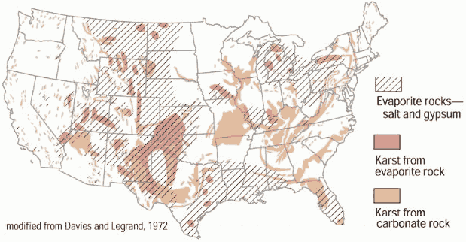

Slide 18
How sink holes are made???
Play animation
Play another animation

Slide 19
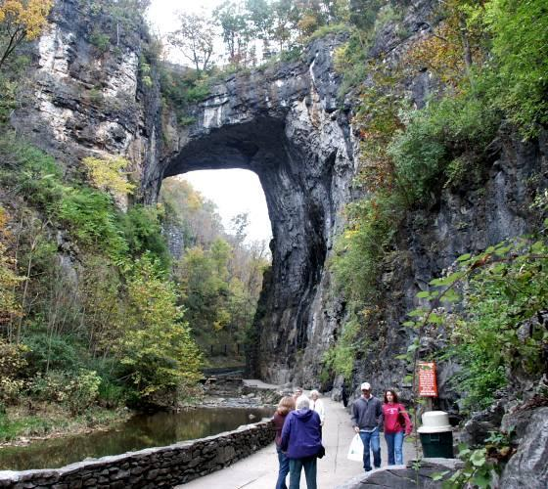
Natural Bridges
When the roof of a cavern collapses in several places, a relatively straight line of sinkholes forms.
The uncollapsed rock between each pair of sinkholes forms an arch of rock called a natural bridge.

Slide 20
Karst Topography
karst topography a type of irregular topography that is characterized by caverns, sinkholes, and underground drainage and that forms on limestone or other soluble rock
Common features of karst topography include many closely spaced sinkholes and caverns.
Generally, karst topography forms in regions where the climate is humid and where limestone formations exist at or near the surface.

Slide 21
You tube Karst topography
KY Karst
Asia Karst

