Slide 1
Lipids
1
Notes:
1

Slide 2
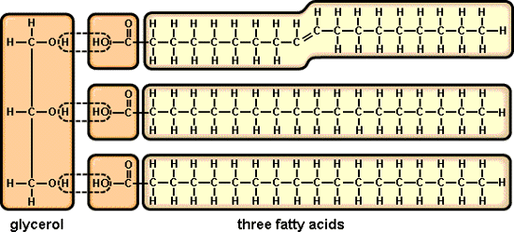
Triglycerides (fats)
Made from 1 glycerol + 3 fatty acid tails=triacylglycerol
2

Slide 3
Lipids
General term for compounds which are not soluble in water (don’t mix)
Made of Carbon & Hydrogen & a lil O
Examples:
1. Fats
2. Phospholipids (Cell membranes)
3. Oils
4. Waxes
5. Steroid hormones
3
Notes:
3

Slide 4
Lipids
Six functions of lipids:
1. Long term energy storage
2. Protection against heat loss (insulation)
3. Protection against physical shock
4. Protection against water loss
5. Chemical messengers (hormones)
6. Major component of membranes (phospholipids)
4
Notes:
4

Slide 5
Lipids
*Monomer: a fatty acid/glycerol unit
* Function: Fuel for the cells; also involved in making membranes
*Examples: fats, phospholipids and steroids
Lipids are diverse compounds that consist mainly of carbon and hydrogen atoms linked together by nonpolar covalent bonds.
5

Slide 6
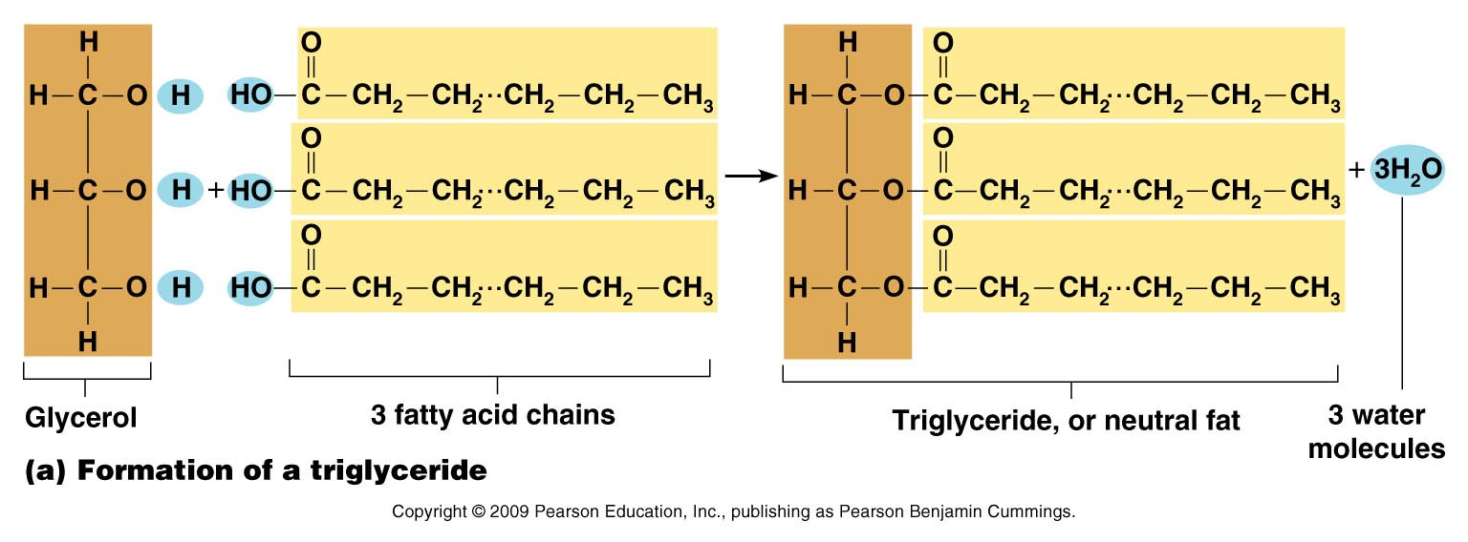
6

Slide 7
7

Slide 8
Lipids
Triglycerides: composed of 1 glycerol and 3 fatty acids.
H
H-C----O
H-C----O
H-C----O
H
O
C-CH₂-CH₂-CH₂-CH₂-CH₂-CH₂-CH₂-CH₂-CH₂-CH₃
=
O
C-CH₂-CH₂-CH₂-CH₂-CH₂-CH₂-CH₂-CH₂-CH₂-CH₃
=
O
C-CH₂-CH₂-CH₂-CH
fatty acids
=
glycerol
=CH-CH₂-CH₂-CH₂-CH₂-CH₃
8
Notes:
8

Slide 9
Fatty Acids
There are two kinds of fatty acids you may see these on food labels:
1. Saturated fatty acids: no double bonds (bad) solid-animal fats-bacon,lard,butter
2. Unsaturated fatty acids: double bonds (good)liquid at room temp-olive oil, corn oil
O
C-CH₂-CH₂-CH₂-CH₂-CH₂-CH₂-CH₂-CH₂-CH₂-CH₃
=
saturated
unsaturated
O
C-CH₂-CH₂-CH₂-CH
=
=CH-CH₂-CH₂-CH₂-CH₂-CH₃
9
Notes:
9

Slide 10
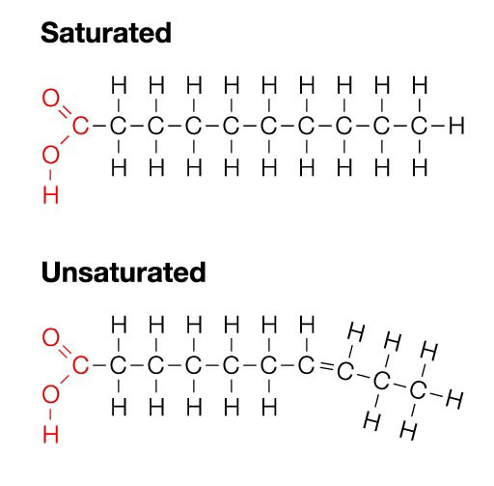
Saturated vs Unsaturated
10

Slide 11
Saturated vs Unsaturated
11

Slide 12
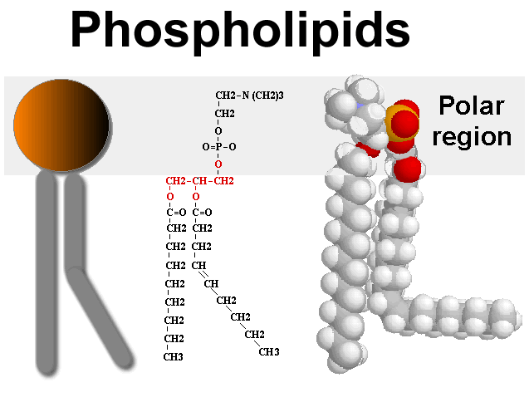
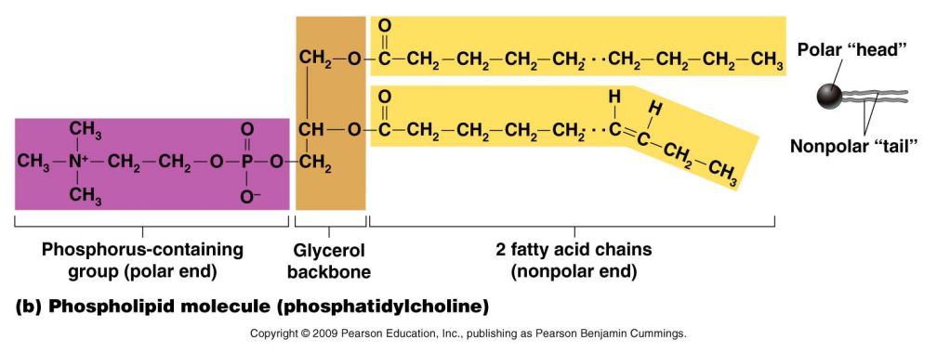
Phosphlipids
Phospholipids, a major component of cell membranes, are structurally similar to fats, but they contain the element phosphorous and have only two fatty acid chains instead of three.
12

Slide 13
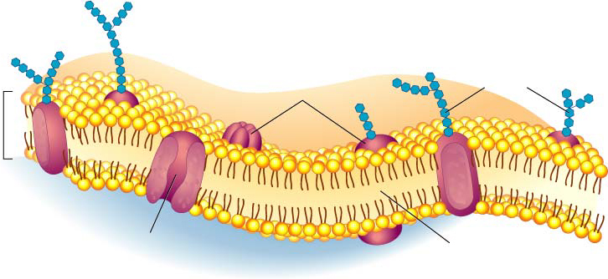
Cell Membrane
Proteins
Transport
Protein
Phospholipids
13

Slide 14
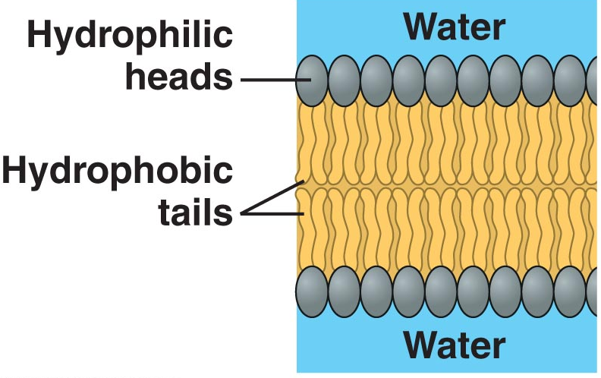
Cell membrane
14

Slide 15
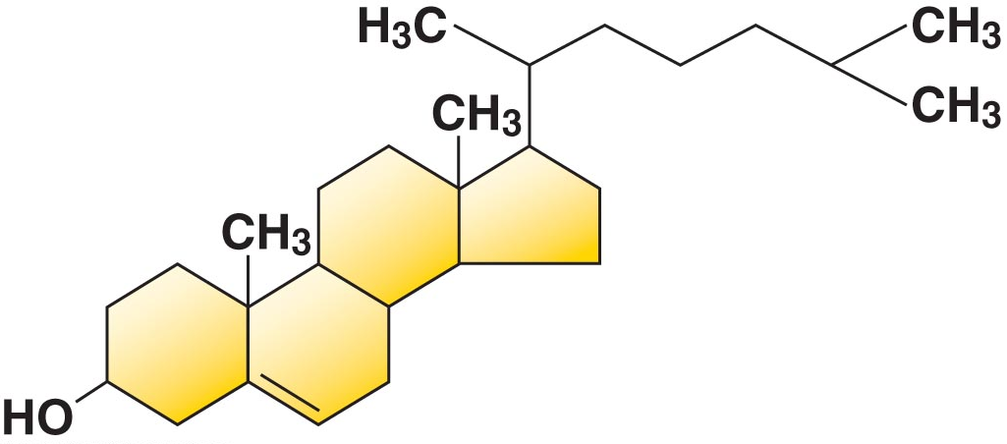
Steroids
Steroids are lipids whose carbon skeleton is bent to form four fused rings.
Cholesterol (a steroid) is a common substance in animal cell membranes.
Cholesterol is also the raw material used to form vitamin D, some hormones (sex hormones and cortisol), and bile salts.
15

Slide 16
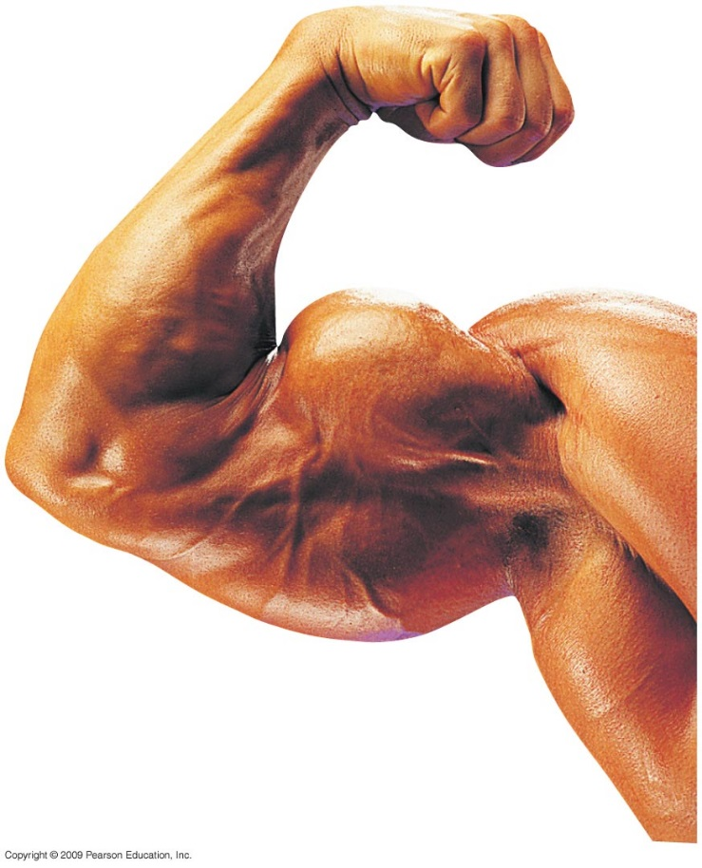
Anabolic steroids
Anabolic steroids are synthetic variants of testosterone that can cause a buildup of muscle and bone mass
They can be sold as prescription drugs and
used to treat certain diseases
They may also be abused with serious
consequences, such as liver damage that
can lead to cancer
16

Slide 17
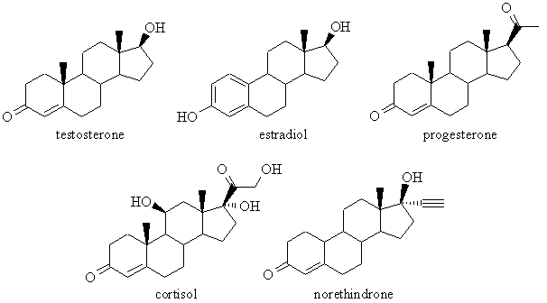
Steroids
17

