Slide 1
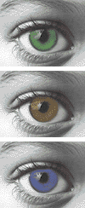
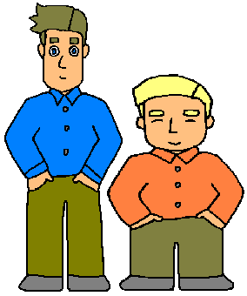
Exploring Mendelian Genetics 11-3
http://www.eslkidstuff.com/images/tallshort.gif
http://sps.k12.ar.us/massengale/genetics%20tutorial.htm

Slide 2
GENES are more complicated than Mendel thought
ENVIRONMENT influences
____________________________ the ________________________.
= ________________________
Genes ________ the ______ for development, but how plan unfolds also _______ on ______________conditions.
expression of genes
“Nature vs Nurture”
provide plan
depends environmental

Slide 3
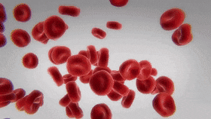
GENES are more complicated than Mendel thought
Some traits have ____________ allele __________
= ____________________
EX: blood type
Allele choices ___ ___ ___
MORE than 2
choices
MULTIPLE ALLELE TRAIT
A
B
O

Slide 4
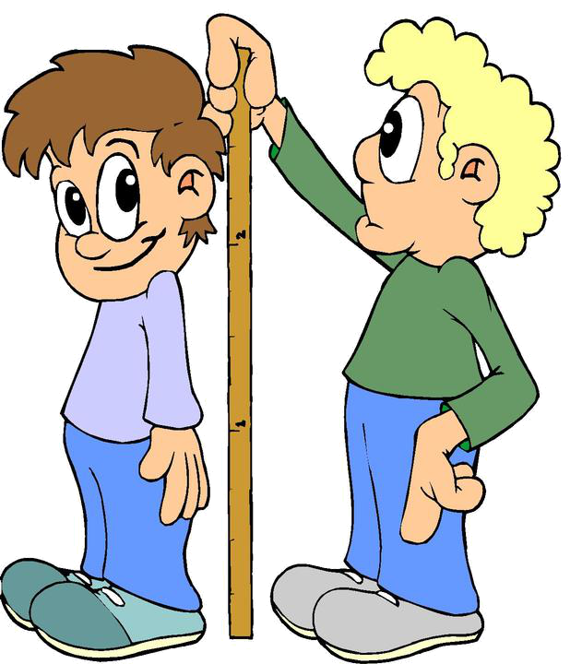
GENES are more complicated than MENDEL thought
Some traits are determined by
____________________________
= __________________
EX: human height. intelligence, skin & eye color
MORE THAN ONE GENE
POLYGENIC TRAIT
http://www.bcps.org/offices/lis/models/life/images/grow.JPG

Slide 5
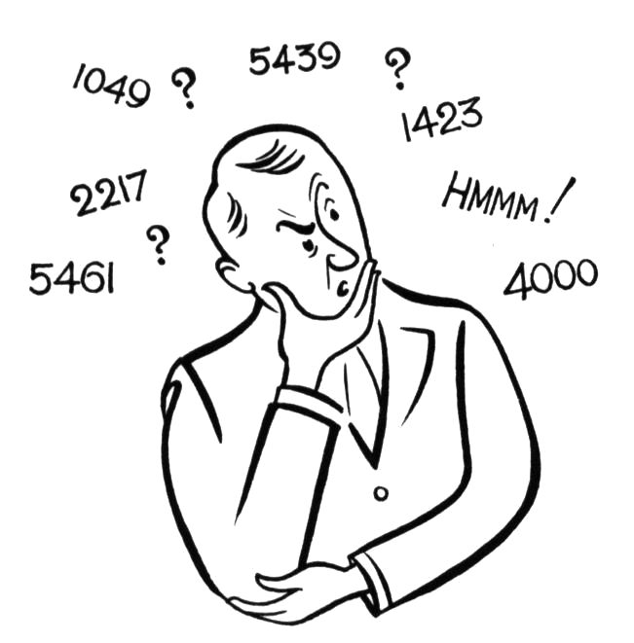
GENES are more complicated than MENDEL thought
Traits determined by ____________ _________ have _____ “___________” phenotypes
MORE than
ONE gene
many
in-between
http://www.newtonswindow.com/problem-solving.htm

Slide 6
GENES are more complicated than MENDEL thought
KINDS OF DOMINANCE
____________________
____________________
____________________
COMPLETE DOMINANCE
INCOMPLETE DOMINANCE
CO-DOMINANCE

Slide 7
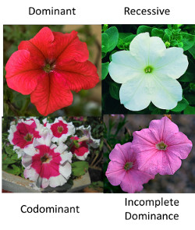

Slide 8
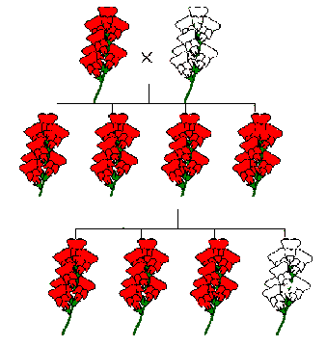
COMPLETE DOMINANCE
Dominant masks
recessive
__________ allele _______ the ___________ one
PATTERN ? ____________ allele ________
in a _____ratio in the ____ generation
Recessive
returns
3:1
F₂
http://www.emc.maricopa.edu/faculty/farabee/BIOBK/BioBookTOC.html

Slide 9
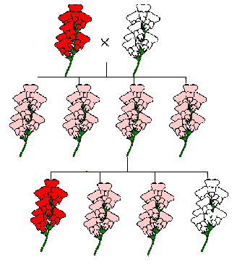
INCOMPLETE DOMINANCE
DON’T SEE
__________ expected
_____ ratio in
F₂ generation
_____________ organisms with one dominant and one recessive allele show a _________ in-between trait
3:1
Heterozygous
BLENDED
Image modified from: http://www.emc.maricopa.edu/faculty/farabee/BIOBK/BioBookTOC.html

Slide 10
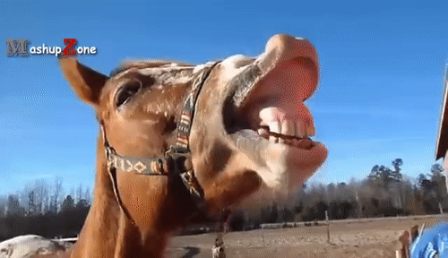
CO-DOMINANCE
BOTH
_______ traits are expressed at ___________ (_____________________) in heterozygote
SAME TIME
NO BLENDING
ROAN
A ________HORSE has ______________ hair and __________ hair
side by side
BOTH RED
WHITE

Slide 11
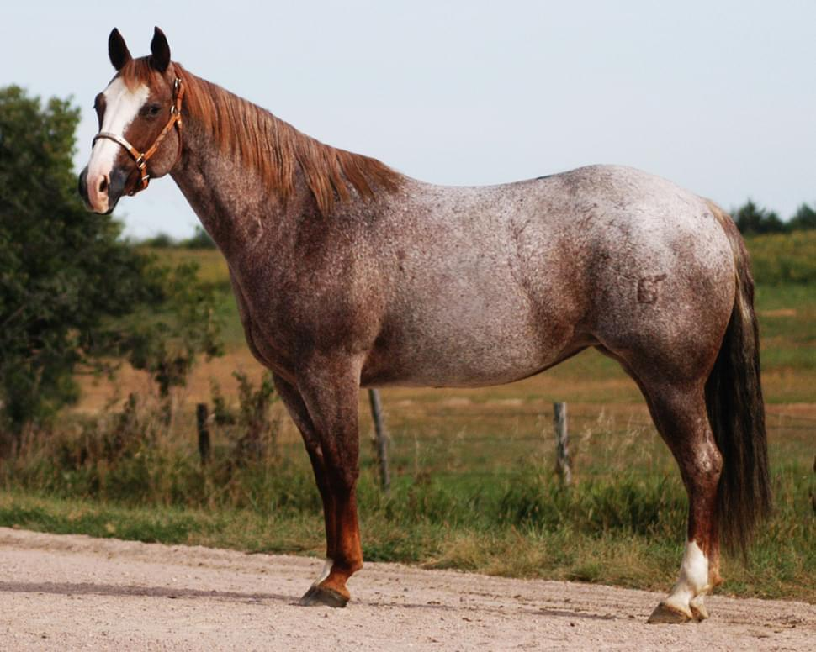
CO-DOMINANCE
BOTH
_______ traits are expressed at ___________ (_____________________) in heterozygote
SAME TIME
NO BLENDING
ROAN
A ________HORSE has ______________ hair and __________ hair
side by side
BOTH RED
WHITE

Slide 12
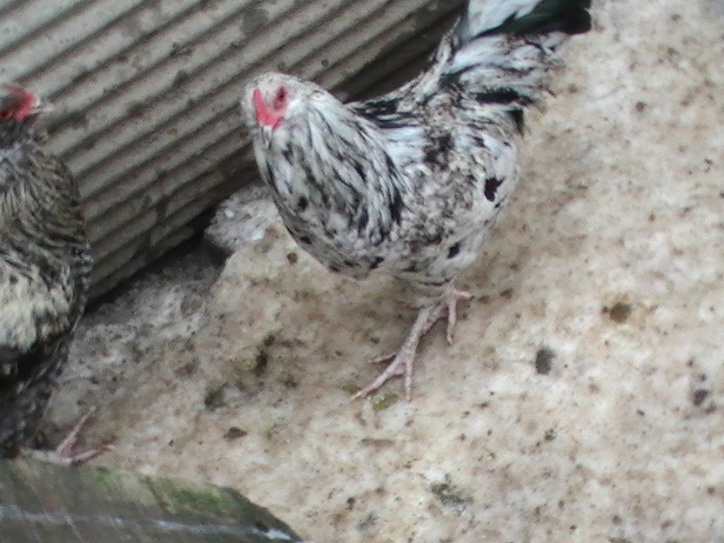
Chickens (Erminette expresses black and white feathers)

Slide 13
CO-DOMINANCE
Both traits are expressed together (NO BLENDING) in heterozygote
Persons with an A allele AND a B allele have blood type AB

Slide 14
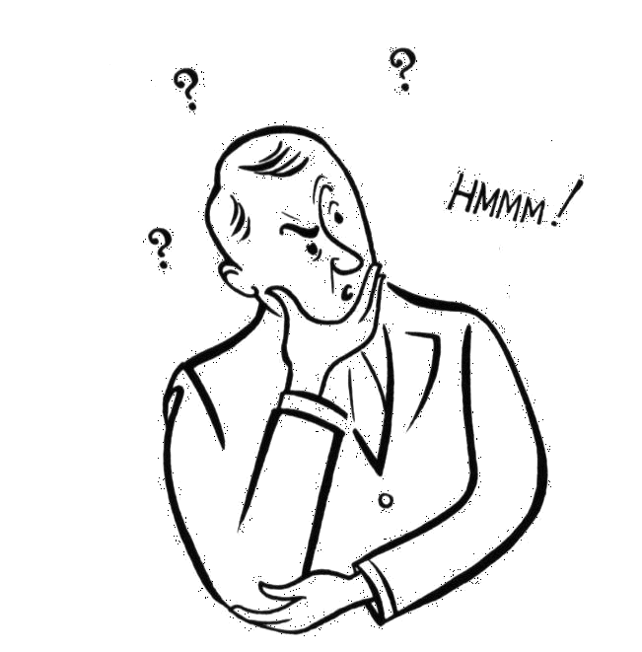
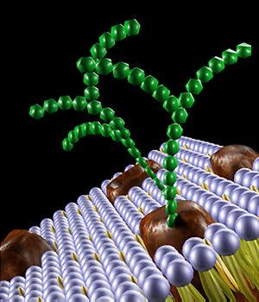
REMEMBER
Membrane proteins with _______ attached that help cells recognize self
= ______________
sugars
GLYCOPROTEINS
http://www.mannanw.com/super-sugars.htm

Slide 15
BLOOD TYPES have more than 2 allele choices = _________________________
MULTIPLE ALLELE TRAIT
The pattern of sugars that is attached is determined by genes
Allele choices are:
_____ ____ ____
A
B
O

Slide 16
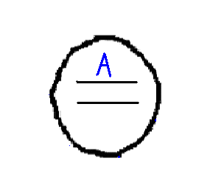
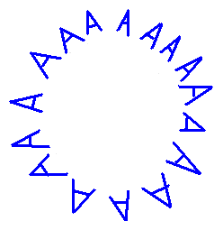
BLOOD TYPES
An A allele tells
the cell to put
“A” glycoproteins
on its surface

Slide 17
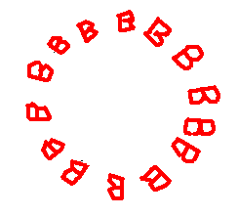
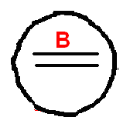
BLOOD TYPES
A B allele tells
the cell to put a
different “B” glycoprotein
on its surface

Slide 18
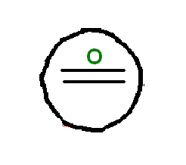
BLOOD TYPES
An O allele tells
the cell NOT to put anything on the surface

Slide 19
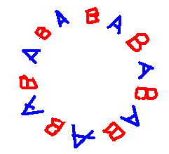
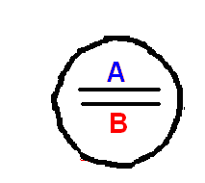
A and B are CO-DOMINANT
A cell with
BOTH an
A and a B allele
has BOTH
“A” and “B”
glycoproteins on its surface

Slide 20
BLOOD TYPES & ALLELES
GENOTYPE | PHENOTYPE (BLOOD TYPE)
I^{A}I^{A}
I^{A}i
I^{B}I^{B}
I^{B}i
ii
I^{A}I^{B}
A
A
B
B
O
AB

Slide 21
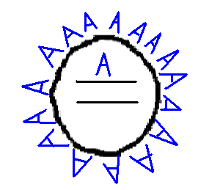
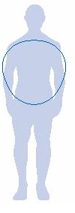
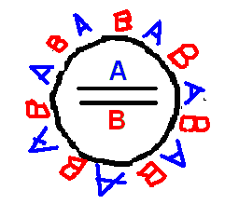
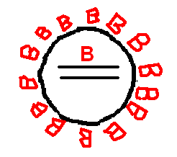
DONOR BLOOD
A and AB see A as “like me”
B and O see A
as Different!
IMMUNE SYSTEM ATTACKS!
Body images modified from: http://www.new-fitness.com/images/body_shapes.jpg

Slide 22
DONOR BLOOD
B and AB see B as “like me”
A and O see B
as Different!
IMMUNE SYSTEM ATTACKS!
Body images modified from: http://www.new-fitness.com/images/body_shapes.jpg

Slide 23
DONOR BLOOD
O
____ can donate to EVERY BLOOD TYPE
= _____________________
Nothing on surface to
recognize as “NOT SELF”
UNIVERSAL DONOR
YOU DON’T HAVE ANYTHING I DON’T HAVE!
Body images modified from: http://www.new-fitness.com/images/body_shapes.jpg

Slide 24
DONOR BLOOD
Only AB sees AB as “like me”
A, B, and O see AB as Different!
IMMUNE SYSTEM ATTACKS!
Body images modified from: http://www.new-fitness.com/images/body_shapes.jpg

Slide 25
AB can only GIVE to AB BUT . . .
AB
______ can RECEIVE FROM
EVERY BLOOD TYPE
= ________________________
UNIVERSAL RECIPIENT
Body image modified from: http://www.new-fitness.com/images/body_shapes.jpg

Slide 26
BLOOD TYPE FREQUENCY IN USA
A | 40%
B | 10%
AB | 4%
O | 46%
http://www.reachoutmichigan.org/funexperiments/agesubject/lessons/newton/BldTyping.html

Slide 27
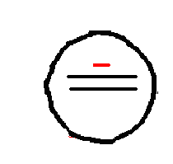
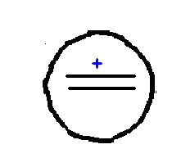
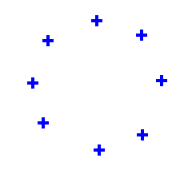
ABO SYSTEM is NOT THE ONLY ONE
Rh⁺ Rh⁻

Slide 28
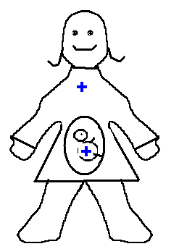
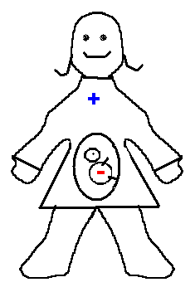
OTHER BLOOD TYPES
____________________ IF:
NO PROBLEMS
MOM is _____ & BABY is ____
Rh⁺
Rh⁺
MOM is _____ & BABY is _____
Rh⁺
Rh⁻
Image modified from: http://www.wsd1.org/lessonplans/images/Body.gif

Slide 29
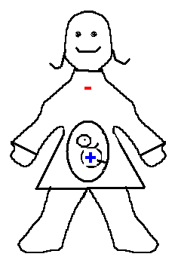
Can be a ___________ IF: Mom is _____ Baby is _____
PROBLEM
Rh⁻
Rh+
1st baby OK but few baby cells
entering mom’s bloodstream
put mom’s immune system on
alert for + cells.
Next + baby, mom’s immune
system can attack baby as it is
growing
Mom given shot after 1st birth prevents this
Image modified from: http://www.wsd1.org/lessonplans/images/Body.gif

Slide 30
Sex-Linked Traits
Characteristics that are inherited from genes found on the sex chromosomes.
Sex Determination
Females – XX
Males – XY
Almost all sex-linked traits are found on the X chromosome
Y chromosome contains very few genes and is mainly involved in sex determination

Slide 31
Sex-Linked Traits
It is possible for a female to be a carrier of an X-linked trait, but not express it
Men will express all X-linked traits they inherit

Slide 32
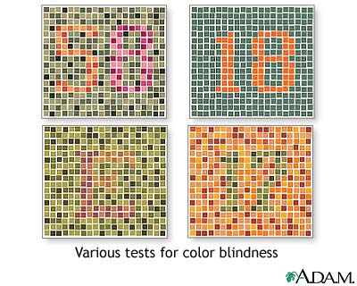
Example: Color Blindness
Various tests for color blindness.

Slide 33
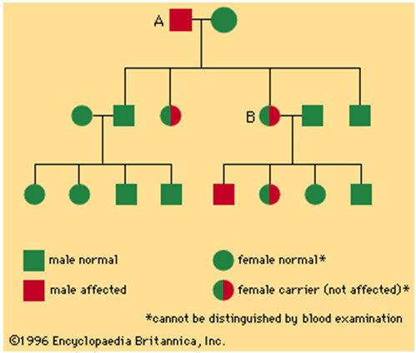
Example- Hemophilia

Slide 34
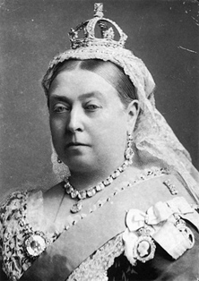
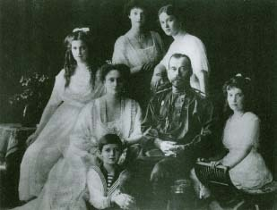
A high incidence of hemophilia has plagued the royal families of Europe
Was the down fall to the
Royal families -Queen Victoria)
Russia’s last Czar

Slide 35
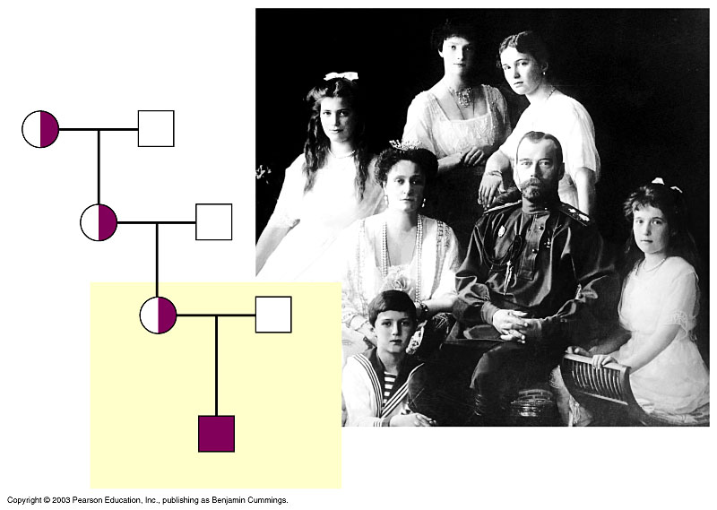
The Last Czar

Slide 36
Sex-influenced traits
characteristic may appear in both sexes but expression of the phenotype differs.
Example: EARLY BALDING (pattern baldness) in humans. Heterozygous men (b+/b) lose their hair; heteroyzgous women do not have significant hair loss.
Homozygous men or women (b/b) become bald. The trait is therefore dominant in men, recessive in women. (We used b to designate the mutant baldness allele even though the allele is dominant in males.)

Slide 37
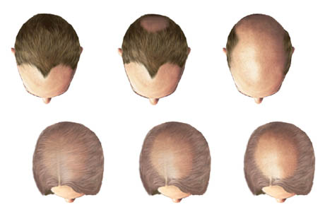
Sex-influenced

Slide 38
Variations on Mendel’s Principles
Codominance, multiple alleles
Pleiotropy (control of more than one phenotypic characterisitic by a single gene)
Polygenic traits (trait controlled by 2 or more genes)
Sex-linked genes
Environmental effects (Epigenetics)

