Slide 1
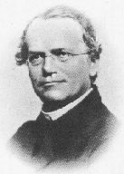
The Work of Gregor Mendel 11-1
http://sps.k12.ar.us/massengale/genetics%20tutorial.htm
http://www.jic.bbsrc.ac.uk/germplas/pisum/zgs4f.htm

Slide 2
Transmission of characteristics from _______________________is called ___________________.
The _________ that studies _____ those
characteristics are _________ from one
generation to the next is called
___________________
parents to offspring
heredity
SCIENCE
how
passed on
Genetics

Slide 3
http://www.jic.bbsrc.ac.uk/germplas/pisum/zgs4f.htm
The __________________ is _________________,
a monk whose _________ of genetic traits was the beginning of our _________________ about _____________________.
Father of Genetics
Gregor Mendel
study
understanding
how genes work

Slide 4
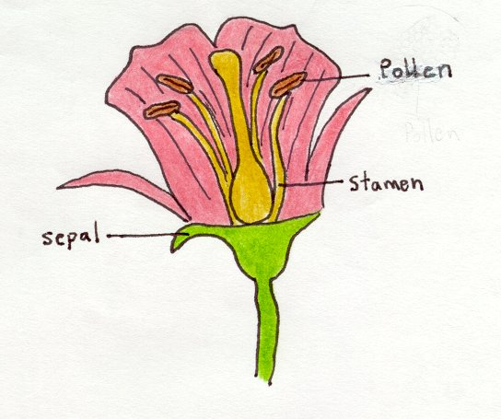
http://hus.yksd.com/distanceedcourses/YKSDbiology/lessons/FourthQuarter/Chapter11/11-1/images/MendelExperiment.gif
Mendel designed
____________ using
__________ in the
monastery garden
_______ part of flower makes
___________ (sperm)
__________ part of flower makes
_______ cells
experiments
Pea plants
MALE
Pollen
FEMALE
egg
http://www.cedarville.edu/academics/education/resource/schools/chca/2scideb/debwebpv.htm

Slide 5
In pea plants, the pollen normally joins with an egg from the _______ plant (=_______________ ) so seeds have “_________________”
same
Self pollinating
ONE parent
http://hus.yksd.com/distanceedcourses/YKSDbiology/lessons/FourthQuarter/Chapter11/11-1/images/MendelExperiment.gif

Slide 6
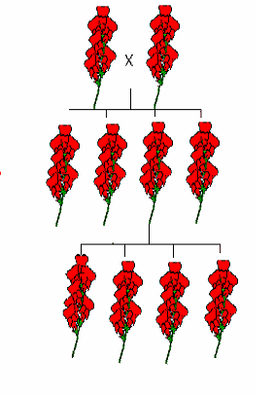
MENDEL’S PEA EXPERIMENTS
Mendel started his experiments with peas that were _________________
= if allowed to
_________________
they would produce
____________________
to themselves.
true breeding
self pollinate
offspring identical
http://hus.yksd.com/distanceedcourses/YKSDbiology/lessons/FourthQuarter/Chapter11/11-1/images/MendelExperiment.gif

Slide 7
MENDEL’S PEA EXPERIMENTS
removed pollen
Mendel ____________________
making parts and ____________
from _______ plant.
This allowed him to
_____________ plants
with ______________
characteristics and
________ the results
added pollen
another
cross-breed
different
study
http://hus.yksd.com/distanceedcourses/YKSDbiology/lessons/FourthQuarter/Chapter11/11-1/images/MendelExperiment.gif

Slide 8
specific characteristic
A _____________________ is called a ____________
Mendel ______________ in peas.
trait
studied 7 traits
Pearson Education Inc,; Publishing as Pearson Prentice Hall

Slide 9
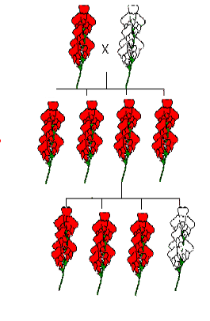
MENDEL’S EXPERIMENTS
P₁
____ generation (_________)
____ generation
(______= offspring)
___ generation
parental
F₁
filial
F₂

Slide 10
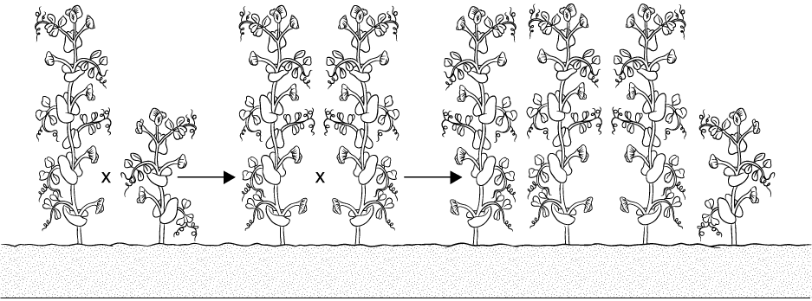
Principles of Dominance
Section 11-1
P Generation
F1 Generation
F2 Generation
Tall
Short
Tall
Tall
Tall
Tall
Tall
Short

Slide 11
Principles of Dominance
Section 11-1
P Generation
F1 Generation
F2 Generation
Tall
Short
Tall
Tall
Tall
Tall
Tall
Short

Slide 12
Principles of Dominance
Section 11-1
P Generation
F1 Generation
F2 Generation
Tall
Short
Tall
Tall
Tall
Tall
Tall
Short

Slide 13
crossed PURE
When Mendel ______________ PLANTS with 2 ______________ traits: (EX: Tall crossed with short)
He always found same pattern:
1. ONLY ______ trait ____________
in the ____ generation BUT . . .
2. ___________ trait ____________ in
the ____ generation
in a _________ ratio
contrasting
ONE showed
F₁
Missing returned
F₂
3:1

Slide 14
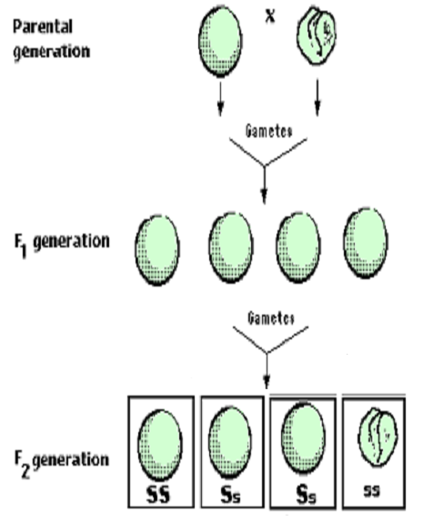
PATTERNS ARE THE KEY
Image modified from: http://www.laskerfoundation.org/rprimers/gnn/timeline/1866.html
http://www.accessexcellence.org/AB/GG/mendel.html

Slide 15
Mendel decided that there must be a __________________ that ________each trait and that
__________ must be able to _______ the other.
pair of FACTORS
control
one factor
HIDE

Slide 16
We now know that Mendel’s ________________ carried on
the pair of________________
_________________
factors are genes
homologous
chromosomes
http://www.emc.maricopa.edu/faculty/farabee/BIOBK/Crossover.gif

Slide 17
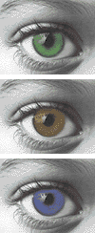
________ gene
_______ for a
trait are called _________.
DIFFERENT
CHOICES
ALLELES
http://sps.k12.ar.us/massengale/genetics%20tutorial.htm

Slide 18
DOMINANT
__________________ = An allele that ________ the presence of another allele
__________________ = An allele that __________________ the
presence of another allele
HIDES
RECESSIVE
is hidden by

Slide 19
Why did the recessive trait disappear in the F₁ generation and reappear in the F₂?
The pattern corresponds
to the ____________ of
______________ during
____________________
movement
chromosomes
MEIOSIS
Image modified from: http://www.laskerfoundation.org/rprimers/gnn/timeline/1866.html

Slide 20
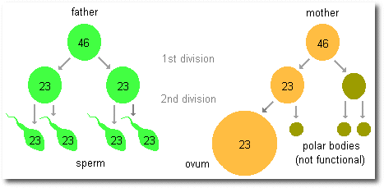
WHAT DOES MEIOSIS HAVE TO DO WITH IT?

Slide 21
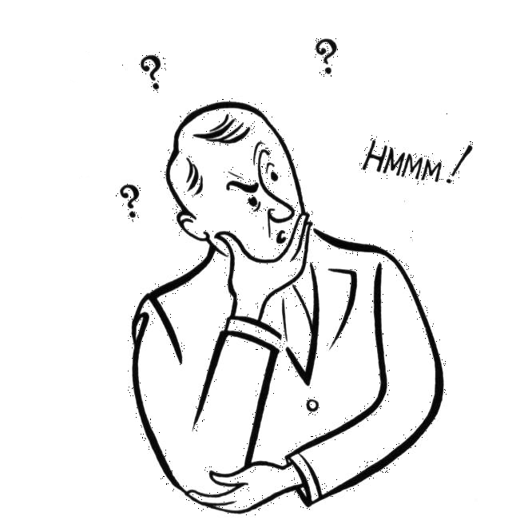
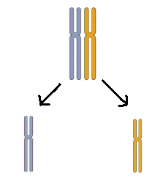
REMEMBER
HOMOLOGOUS
_____________
chromosomes
________________
during
ANAPHASE I
= _________________
SEPARATE
SEGREGATION
Image modified from: http://www.emc.maricopa.edu/faculty/farabee/BIOBK/Crossover.gif

Slide 22
____ offspring __________ an allele for tallness from their _______ parent and an allele for shortness from their ________ parent.
The F₁ plants ALL ___________ but are ___________ an allele for _____________
F₁ received
TALL
SHORT
LOOK TALL
carrying
shortness
Images from: BIOLOGY by Miller & Levine; Prentice Hall Publishing ©2006

Slide 23
EXPLAINING the F₁ CROSS
LAW OF ___________________
SEGREGATION
alleles are separated
when the F₁ plants ______________
When these gametes recombined to make the F₂ generation, the _____________ trait _______________ in ¼ of the offspring
made gametes
recessive
reappears
Image from: BIOLOGY by Miller & Levine; Prentice Hall Publishing ©2006

Slide 24
Alleles and Genes- Amoeba Sisters

