Slide 1
Minerals for Lab Test

Slide 2
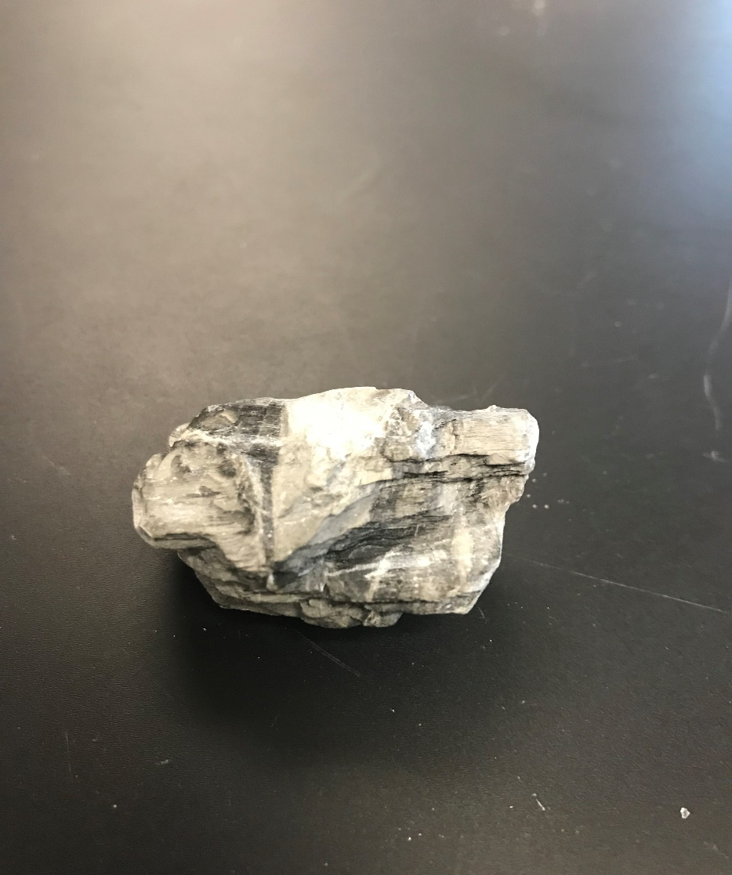
Talc (can scratch with a fingernail)

Slide 3
Gypsum

Slide 4
Calcite (looks like milk)

Slide 5
Fluorite (same color toothpaste)

Slide 6
Feldspar (pink)

Slide 7
Quartz (like a crystal)

Slide 8
Topaz

Slide 9
Biotite (black mica)

Slide 10
Hornblende

Slide 11
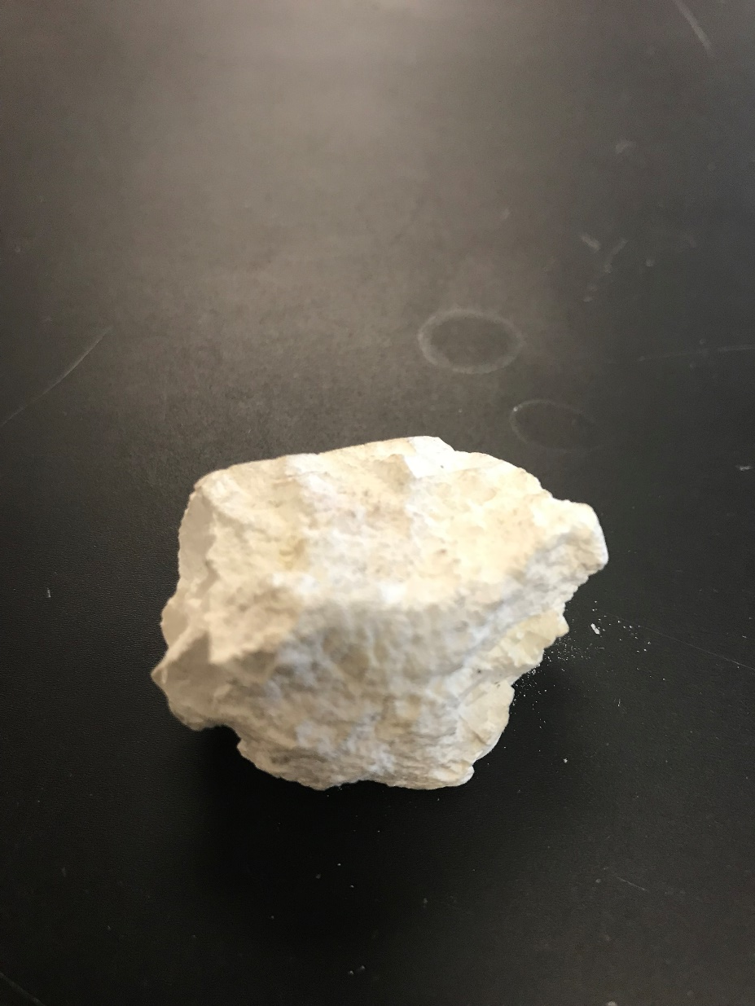
Kaolin (chalk)

Slide 12
Muscovite (white/clear mica)

Slide 13
Olivine (olive green)

Slide 14
Galena (it Galeeeeeeeaaaams uh)

Slide 15
Graphite (you can write with it)

Slide 16
Pyrite (fool’s gold)

Slide 17
Sulfur

Slide 18
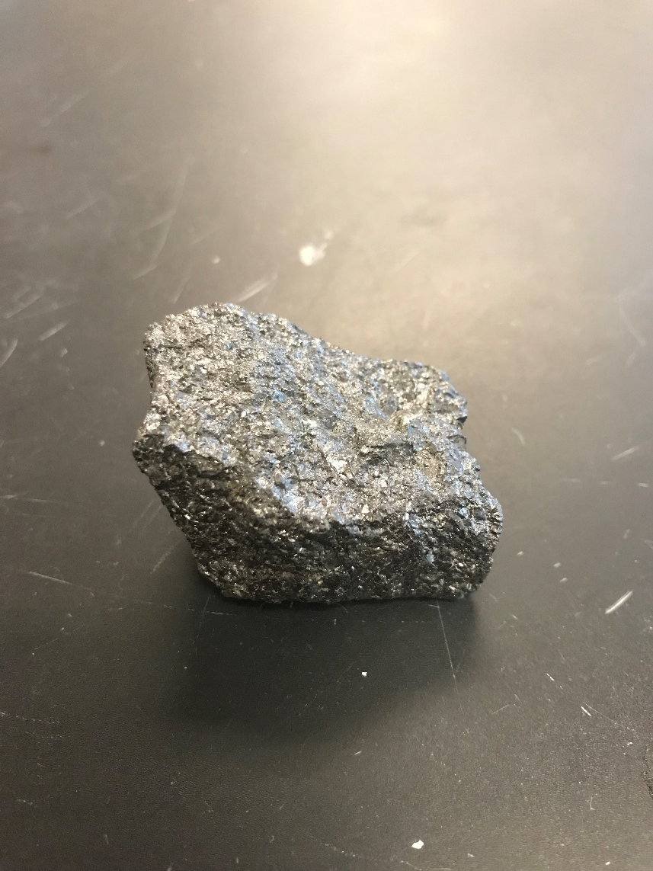
Magnetite (magnetic)

Slide 19
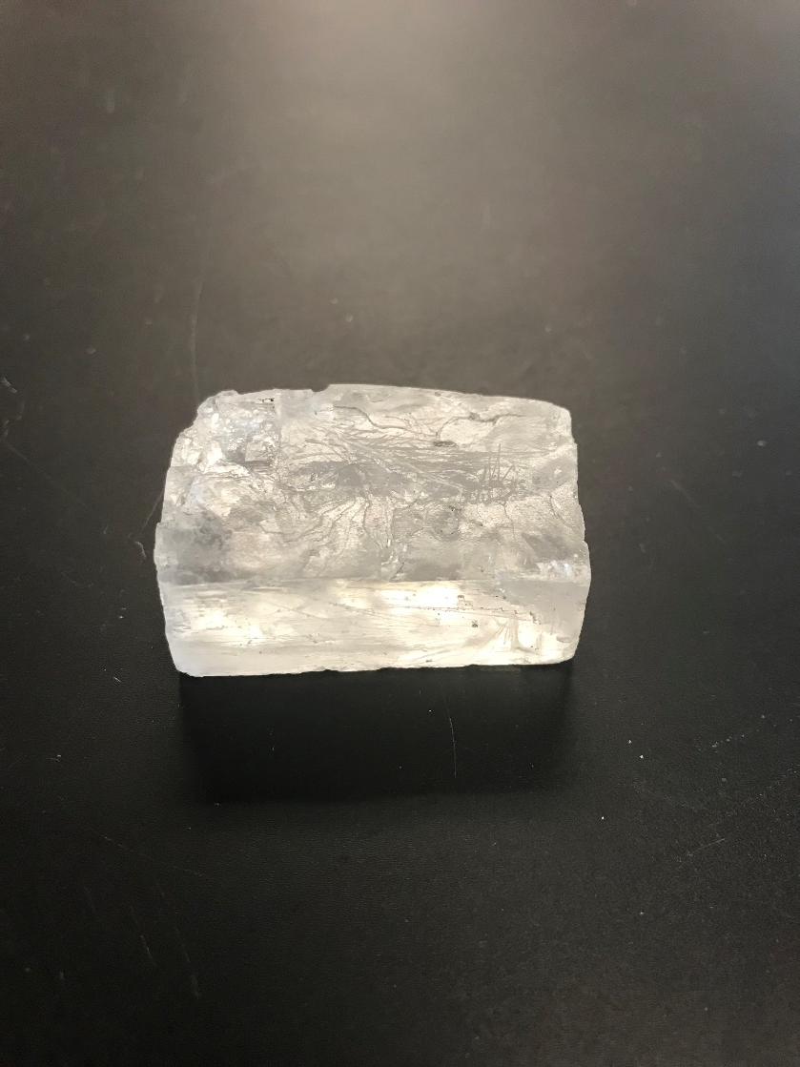
Halite (salt rock)

