Slide 1
Classes of Non-Silicates

Slide 2
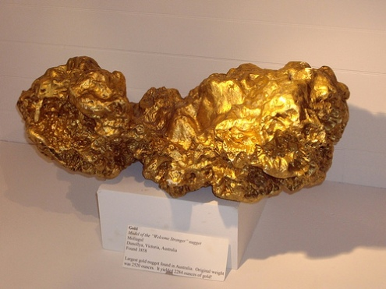
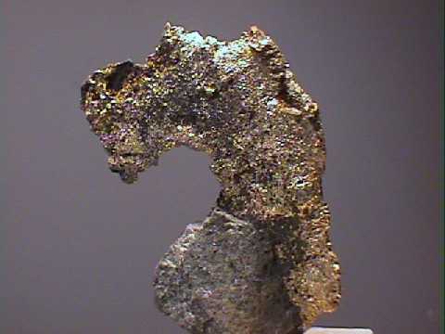
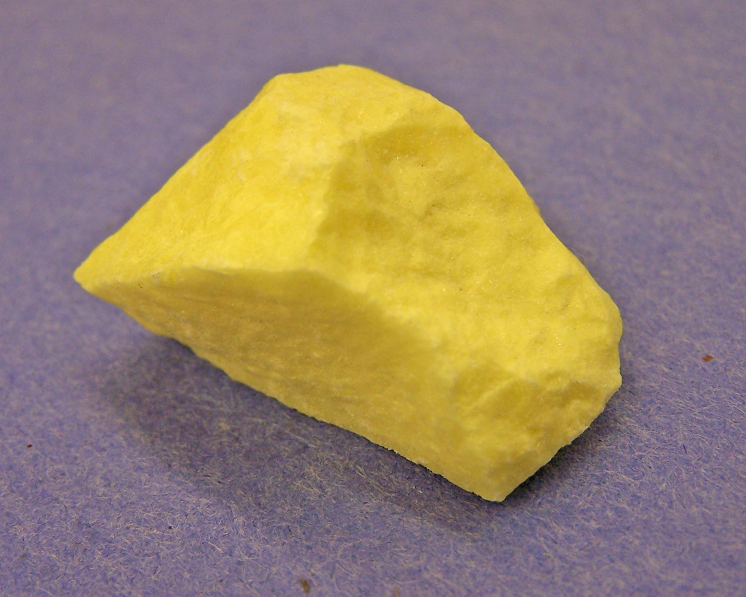
Native Elements
Contain: composed of only one element
Examples: gold (Au), silver (Ag), Sulfur (S), Copper (Cu), Iron (Fe), Carbon (as diamonds or graphite)

Slide 3
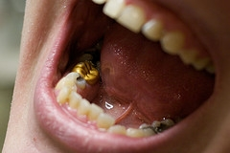
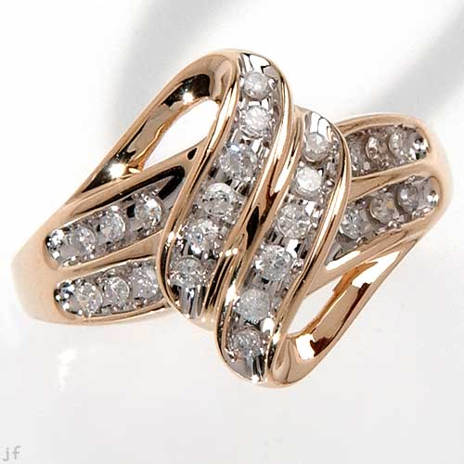
Native Elements
Uses: Jewelry and wiring

Slide 4
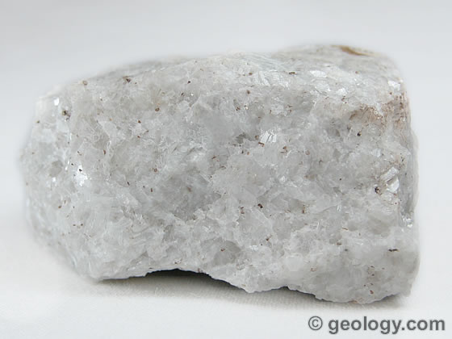
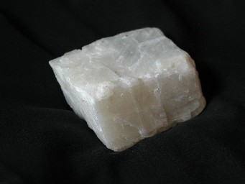
Carbonates
Contain: O₂, C
Examples: calcite (CaCO₃), dolomite (CaCO₃)

Slide 5
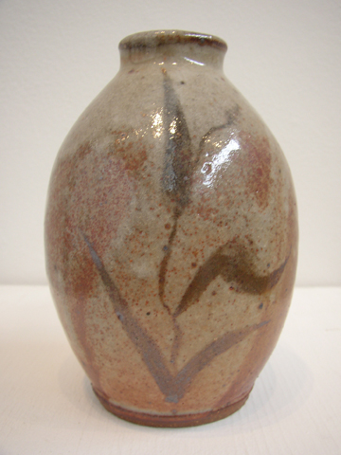
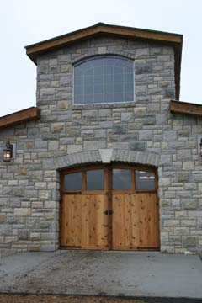
Carbonates
Uses: fireworks, gunpowder, cement, building stone

Slide 6
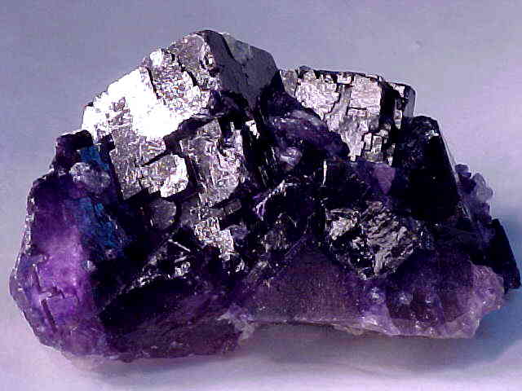
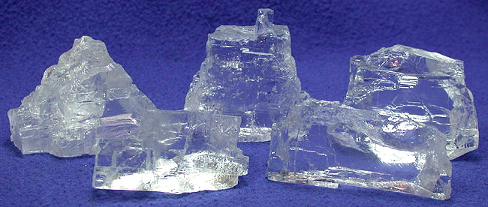
Halides
Contain: F, Cl, I, Br combined with Na, K, Ca
Examples: Halite (NaCl), Flourite (CaF₂)

Slide 7
Halides
Uses: rock salt and fertilizer

Slide 8
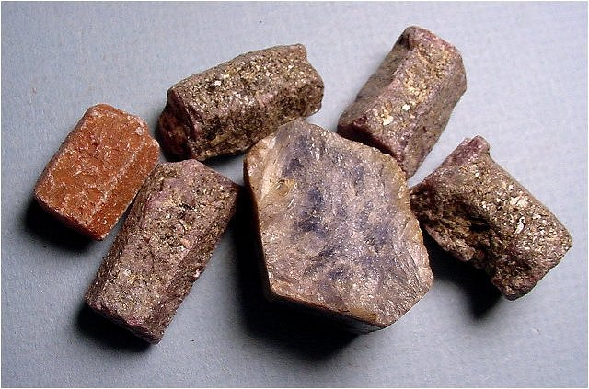
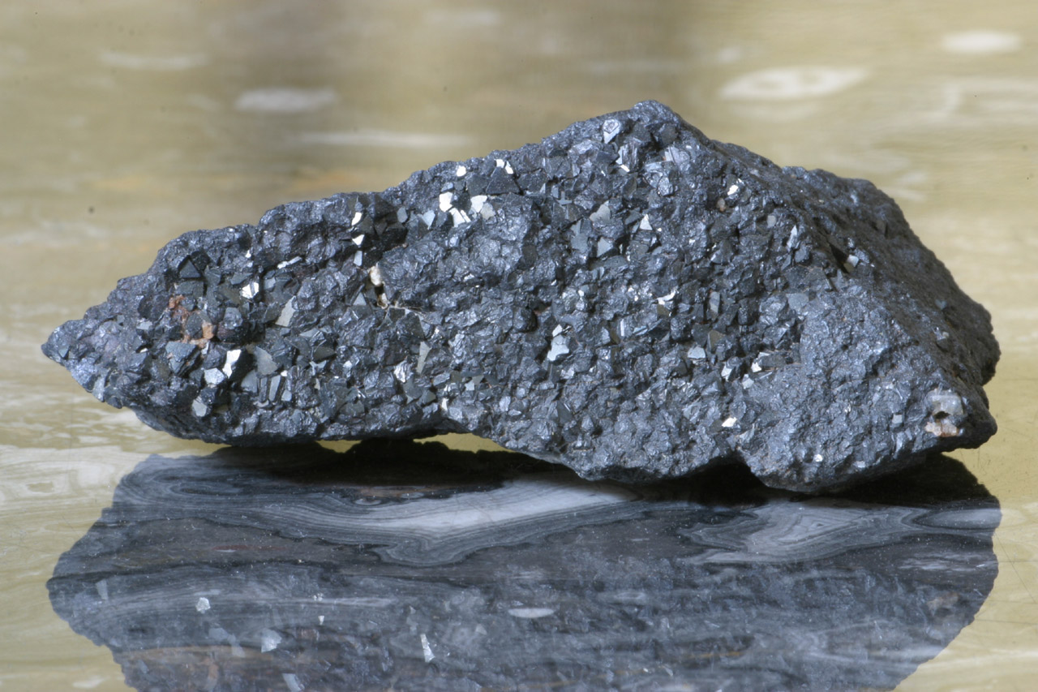
Oxides
Contain: Al or Fe combined with O₂
Examples: Corundum (Al₂O₃), Magnetite (Fe₃O₄)

Slide 9
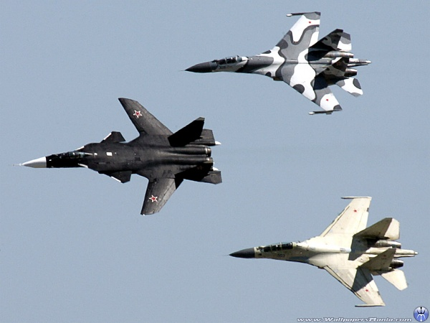
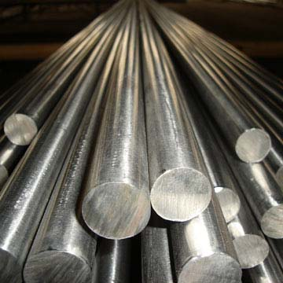
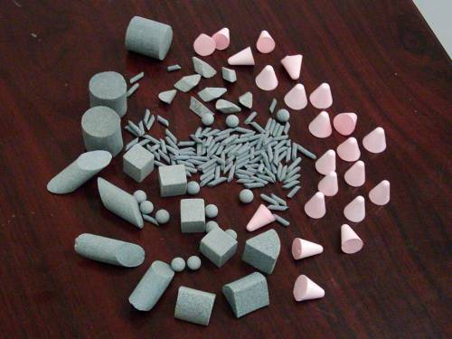
Oxides
Uses: abrasives, air crafts

Slide 10
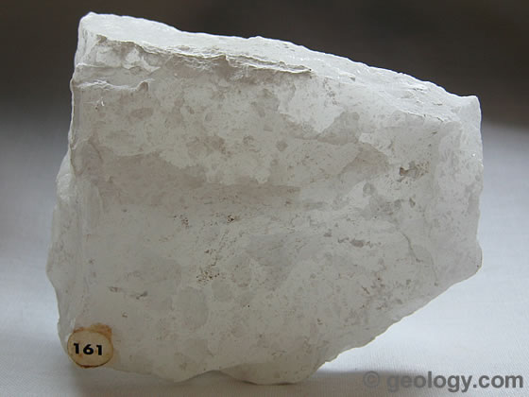
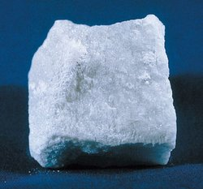
Sulfates
Contain: S and O₂
Examples: gypsum (CaSO₄)

Slide 11
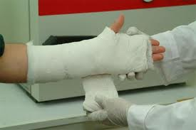
Sulfates
Uses: white sand used for cosmetics, toothpaste, paint

Slide 12
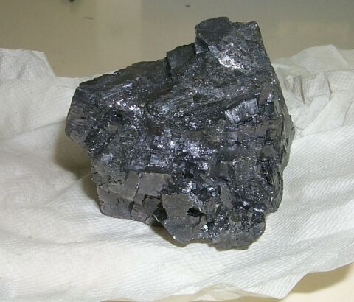
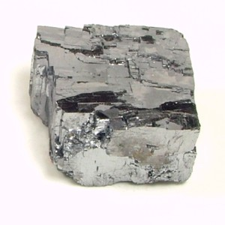
Sulfides
Contain: one or more Pb, Fe, or Ni combined with S
Examples: Galena (PbS)

Slide 13
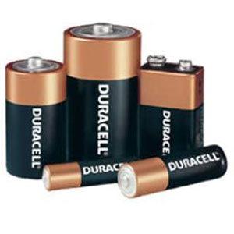
Sulfides
Uses: batteries, medicines, electronic parts

