Slide 1
Rules for Reading Pedigrees

Slide 2
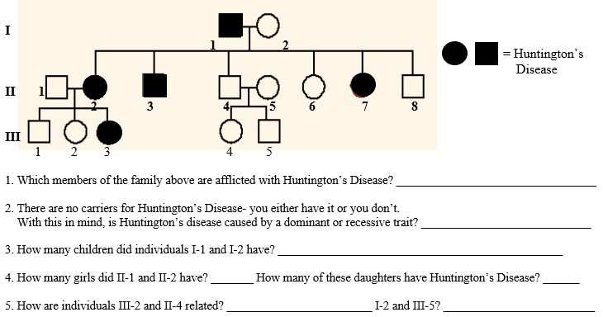

Slide 3
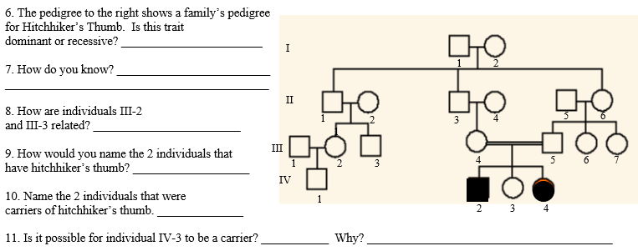

Slide 4
