Slide 1
Proteins
1
Notes:
1

Slide 2
Proteins (Polypeptides)
Chains of Amino acids (20 different kinds) bonded together by peptide bonds (polypeptides)
Made of Nitrogen, Carbon, Oxygen, and Hydrogen
Functions:
Regulate cell processes (enzymes)
Form bones and muscles
Transportation of substances into and out of the cell
2
Notes:
2

Slide 3
Amino Acids
3

Slide 4
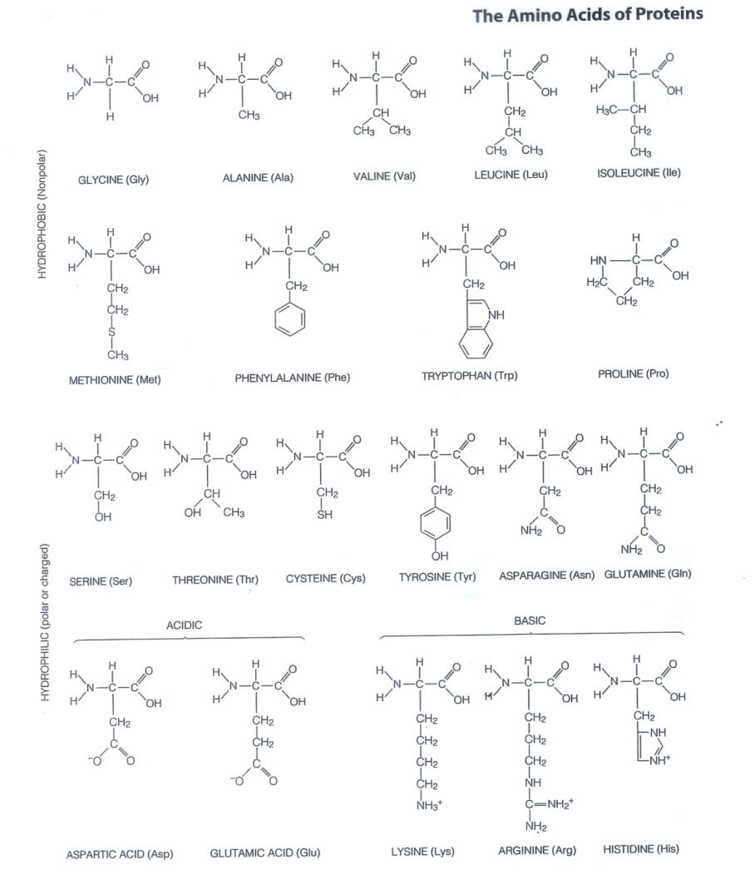
20 amino acids
4

Slide 5
Proteins-CHON
*Monomer: amino acid
*Function: Some have structural roles and some have functional roles
*Examples: collagen, keratin, hormones, enzymes
Proteins account for over 50 % of the organic matter in the body and they have the most varied function of the organic molecules.
5

Slide 6
Proteins (Polypeptides)
Four levels of protein structure:
A. Primary Structure
B. Secondary Structure
C. Tertiary Structure
D. Quaternary Structure
6
Notes:
6

Slide 7
Primary Structure
Amino acids bonded together by peptide bonds (straight chains)
Amino Acids (aa)
aa1
aa2
aa3
aa4
aa5
aa6
Peptide Bonds
7
Notes:
7

Slide 8
Proteins are formed by dehydration synthesis
8

Slide 9
Primary Structure
In order for this or any other protein to perform its specific function, it must have the correct collection of amino acids arranged in a precise order.
9

Slide 10
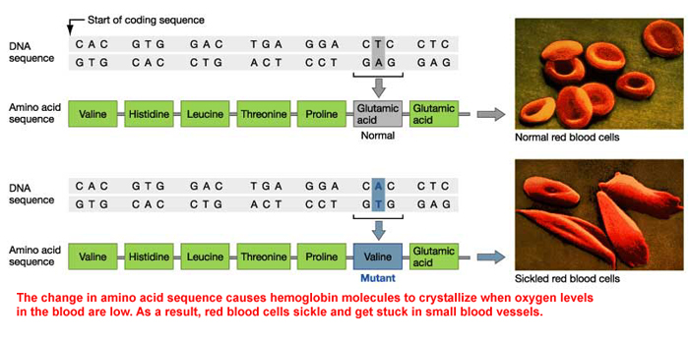
Even a slight change in a protein’s primary structure may affect its overall shape and its ability to function.
10

Slide 11
Secondary Structure
3-dimensional folding arrangement of a primary structure into coils and pleats held together by hydrogen bonds.
Two examples:
Alpha Helix
Beta Pleated Sheet
Hydrogen Bonds
11
Notes:
11

Slide 12
Secondary Structure
The second level, or secondary structure, of protein structure, consists of a chain that is coiled or folded into local patterns.
12

Slide 13
Tertiary Structure
Secondary structures bent and folded into a more complex 3-D arrangement of linked polypeptides
Bonds: H-bonds, ionic, disulfide bridges (S-S)
Call a “subunit”.
13
Notes:
13

Slide 14
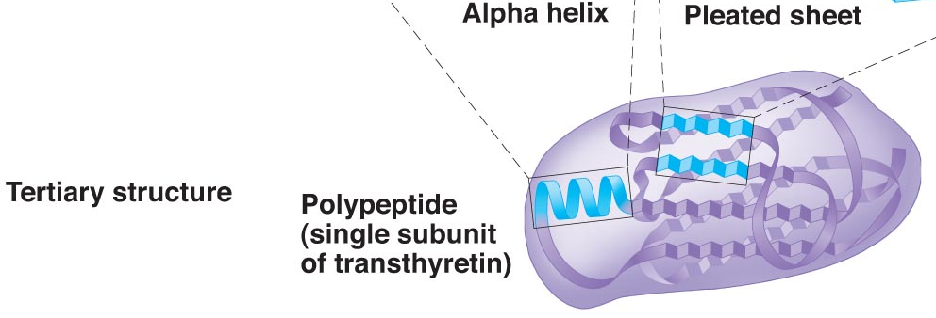
Tertiary Structure
Many globular proteins have the tertiary structure--both helical and pleated sheet regions.
In contrast, many fibrous protein, such as our hair proteins, are almost entirely helical.
14

Slide 15
Quaternary Structure
Composed of 2 or more “subunits”
Globular in shape
Form in Aqueous environments
Example: enzymes & hemoglobin
subunits
15
Notes:
15

Slide 16
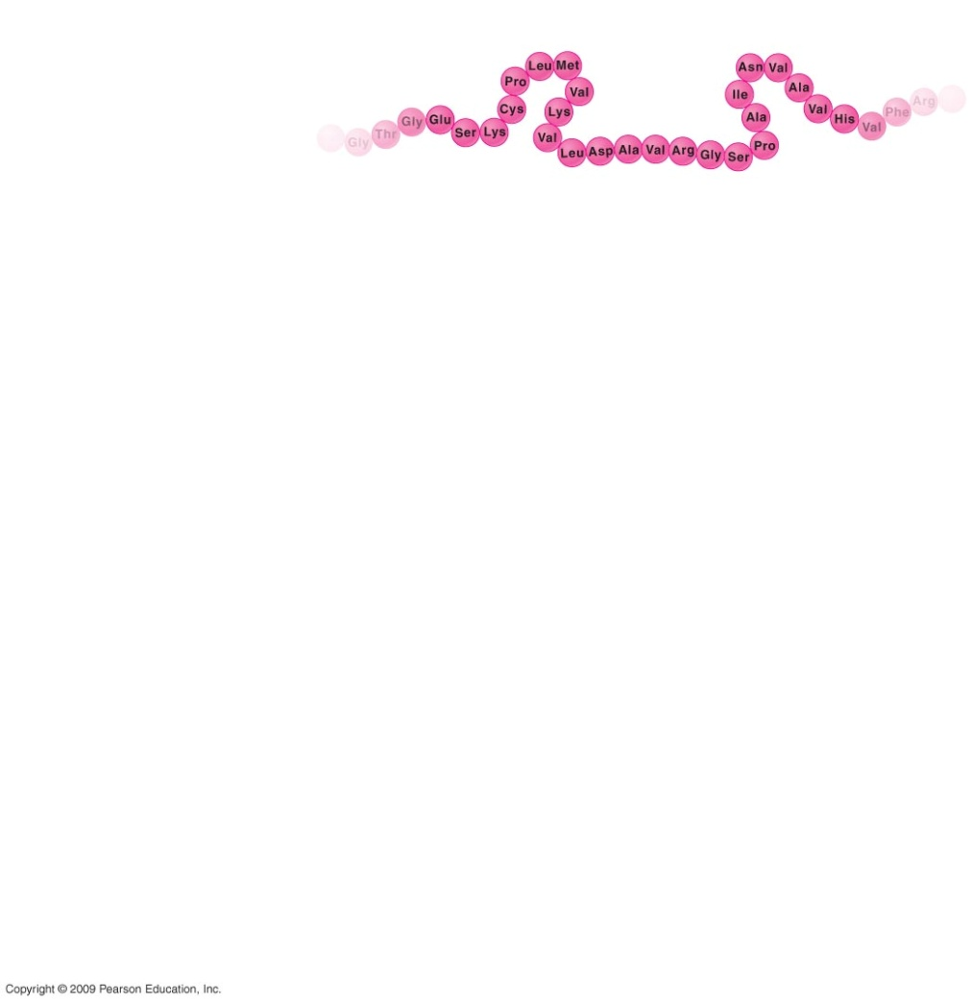
Four levels of protein structure
16

Slide 17
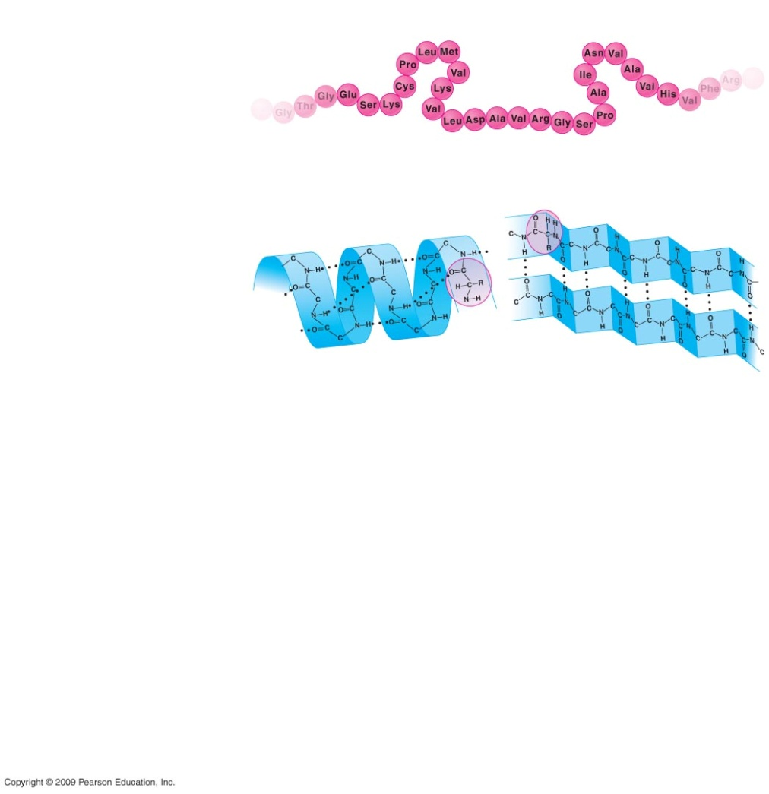
Four levels
17

Slide 18
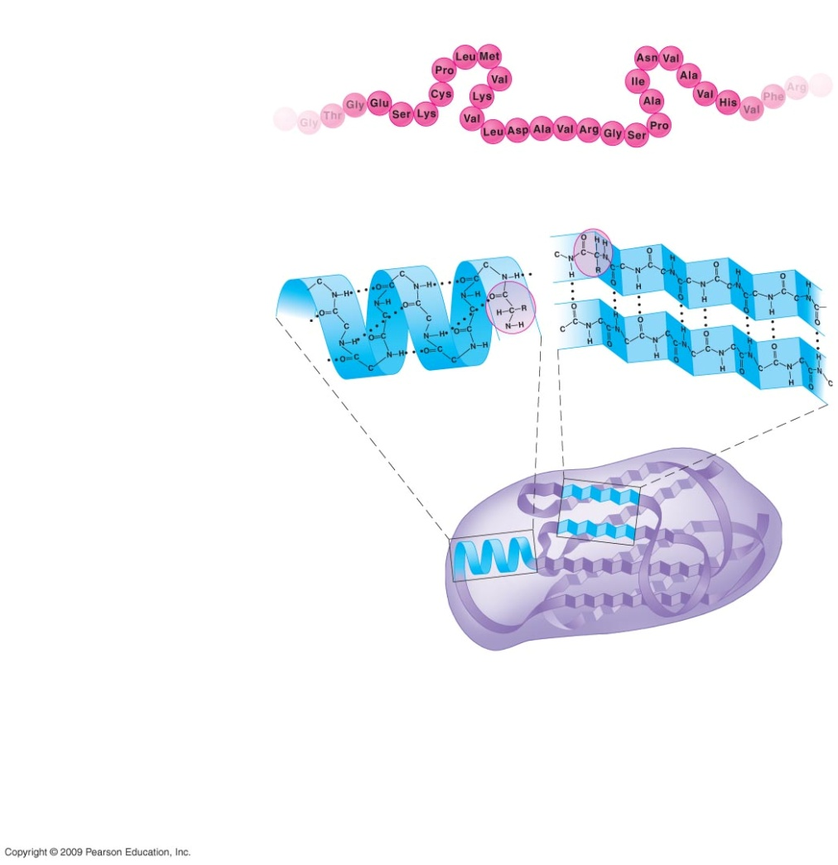
Four levels
18

Slide 19
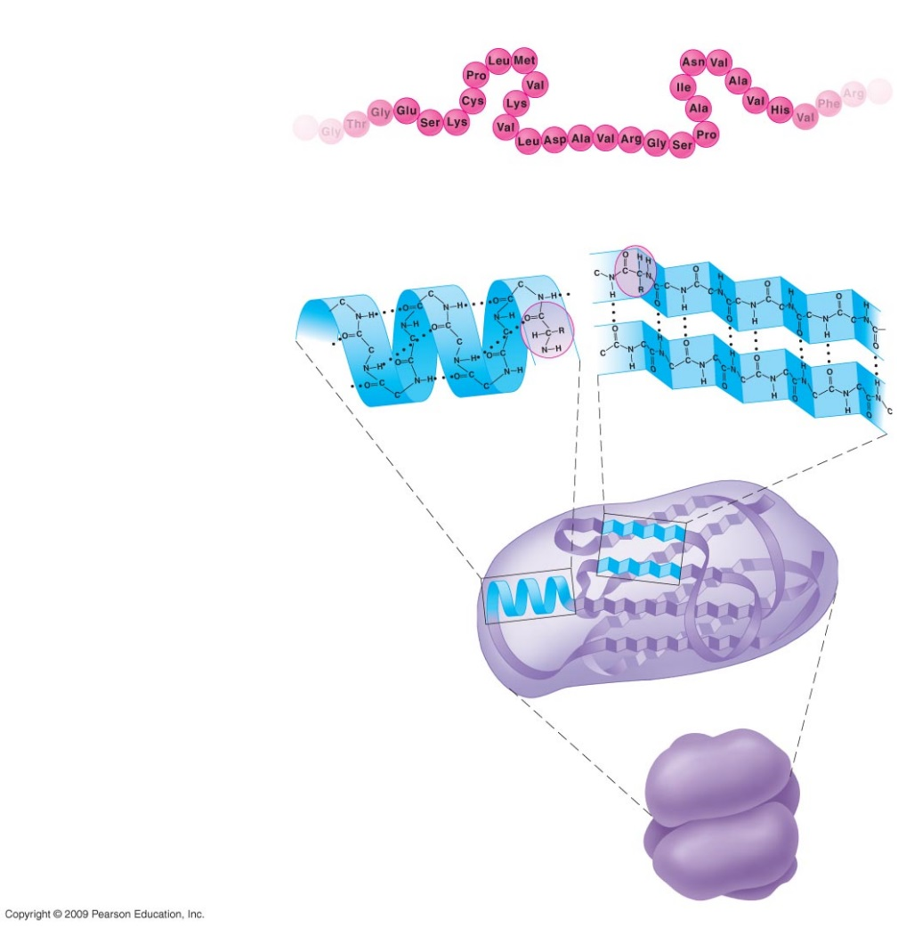
Four levels
19

Slide 20
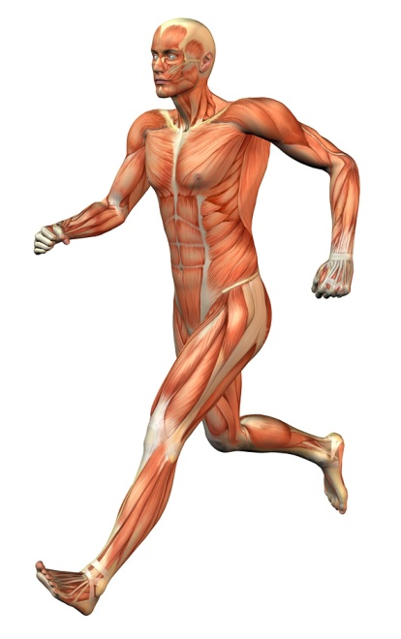
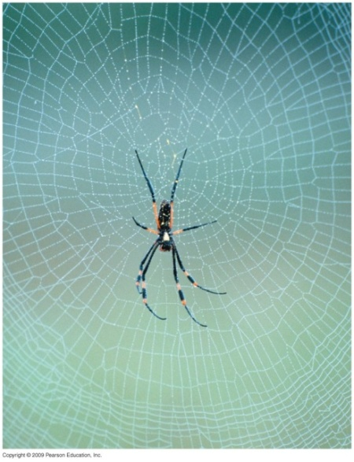
Functions of Proteins
structural proteins— silk of spiders, hair of mammals,fibers that make up our tendons and ligaments
2. contractile proteins— provide muscular movement
20

Slide 21
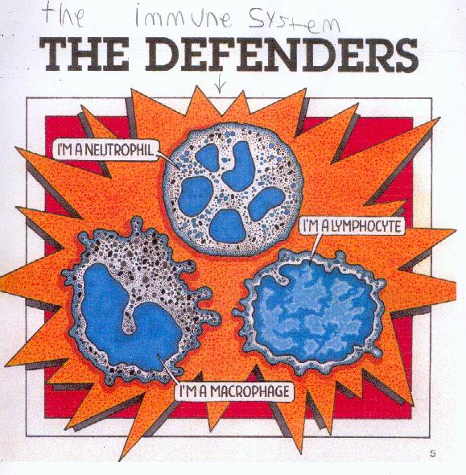
More functions
3. storage proteins— store important amino acids
4. defensive proteins— antibodies which fight infections and are carried in the blood
21

Slide 22
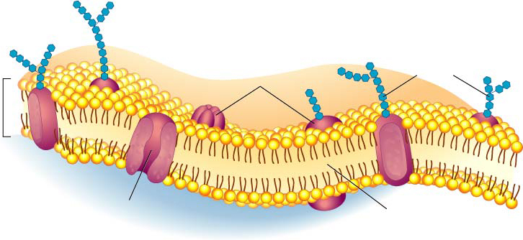
More Functions
5. transport proteins— hemogloblin—iron containing protein in the blood that conveys oxygen from our lungs to other parts of the body.
6. signal proteins— hormones which help
coordinate body activities by serving as messengers from one cell to another
Proteins
Transport
Protein
Phospholipids
22

Slide 23
More Functions
7. enzyme proteins— serve as a chemical catalysts, an agent that changes the rate of chemical reactions without itself being changed into a different molecule in the process.
Enzymes promote and regulate virtually all chemical reactions in cells.
23

Slide 24
Enzymes lowers a reaction's activation energy
24

Slide 25
Based on their overall shape and structure, proteins are classified as either fibrous or globular proteins.
Fibrous Proteins
The strand-like fibrous proteins (a.k.a. structural proteins) appear most of the in body structures.
They are very important in binding structures
together and providing strength in certain
body tissues.
25

Slide 26
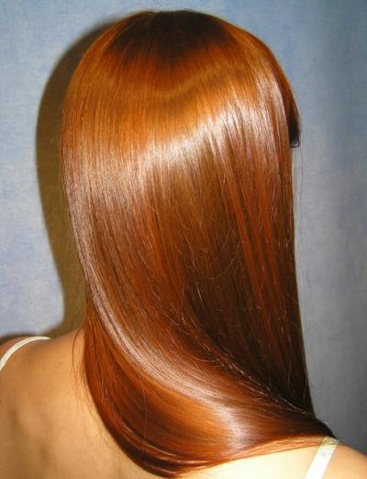
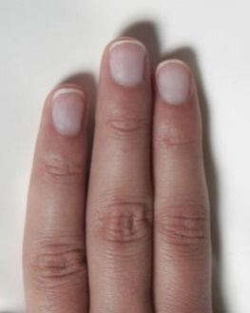
Fibrous
For example, collagen, cartilage, tendons and ligaments, actin and myosin (muscle fibers).
Keratin is the structural protein of hair or nails and the material that makes skin tough.
26

Slide 27
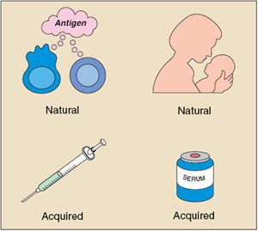
Globular
Globular proteins are mobile, generally spherical molecules that play crucial roles in virtually all biological processes.
Because they do things rather than just form structures, Globular proteins are also called functional proteins.
Functional proteins help provide immunity.
27

Slide 28
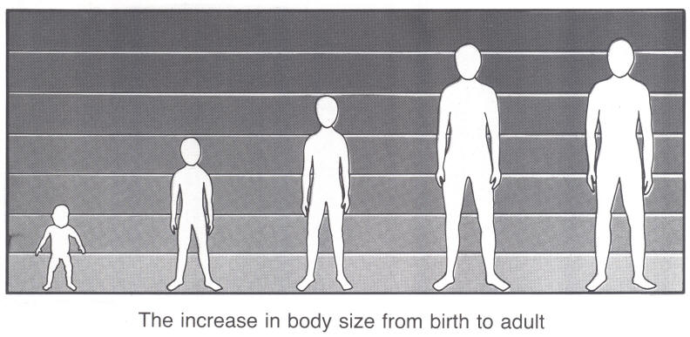
Globular
Others are hormones that help to regulate growth and development.
Others are enzymes—which are biological catalysts (speeds up) that regulate essentially every chemical reaction that goes on in the body.
28

Slide 29
In a process called denaturation, polypeptide chains unravel, losing their specific shape and, as a result, their function.
**Changes in temperature, salt concentration and pH can denature many proteins.
For example, visualize what happens when you fry an egg.
Heat denatures the clear protein surrounding the yolk, making it solid, white and opaque.
29

Slide 30
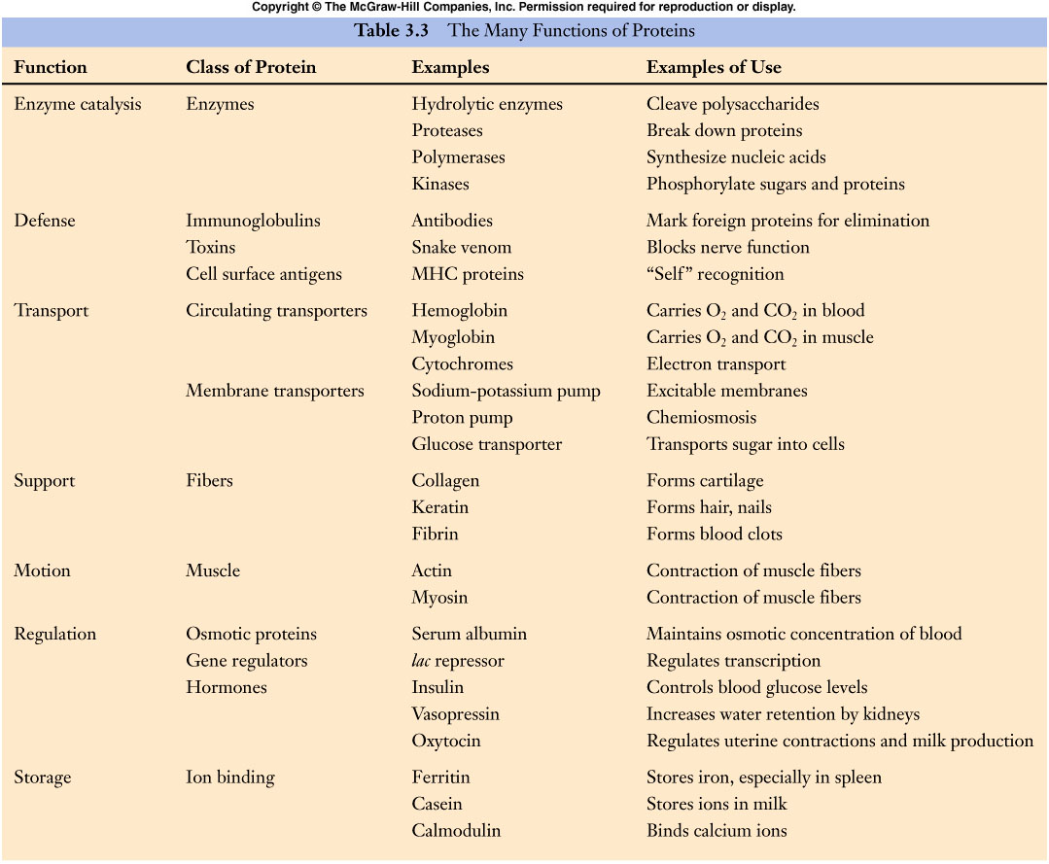
Proteins
30

Slide 31
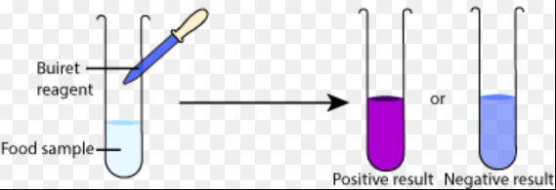
Biuret’s Test for Protein

