Slide 1
Review of 3 rocks before lab test

Slide 2
Igneous Rocks
Forms when magma cools and hardens
2 types of igneous rock
1. Intrusive –mineral crystals are large (coarse)-example is Granite (cools slowly)
2. Extrusive-mineral crystals are small (fine)-examples are Basalt and Rhyolite (cools quickly)

Slide 3
Igneous Rocks
Fill in the Venn Diagram of Igneous Rocks
Intrusive (1,4,5,6)
coarse grain, form beneath the surface, cool slowly, granite is an example
Extrusive (2,3,7,8)
Form above the surface, cool quickly, fine-grained, rhyolite is an example
Both (9) Formed by crystallization of magma

Slide 4
Igneous Rocks
Magma is a mix of molten rock, minerals, gases
The elements in magma are 8 major elements
The most abundant compound in magma is silica (SiO2) (felsic-light in color)
Magmas are classified as basaltic, andesitic and rhyolitic (mafic-dark in color)
Their classification depends on silica

Slide 5
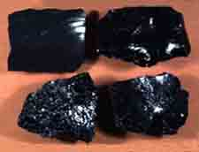
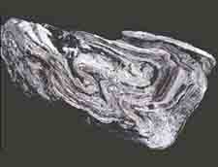
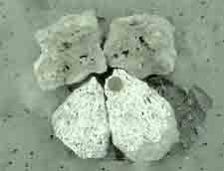
Examples of Igneous Rock
Obsidian Rhyolite Pumice

Slide 6
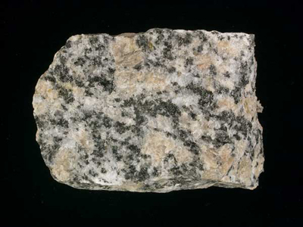
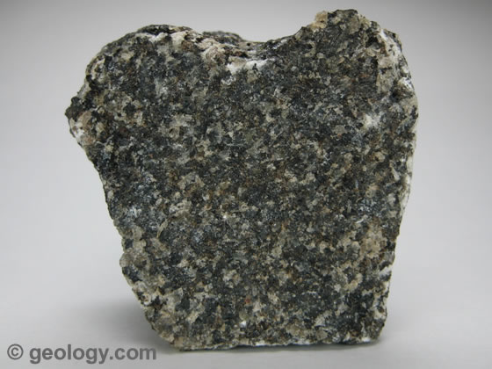
Examples of Igneous Rock
Gabbro Granite

Slide 7
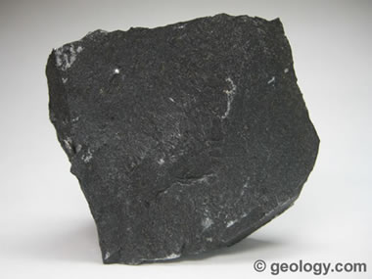
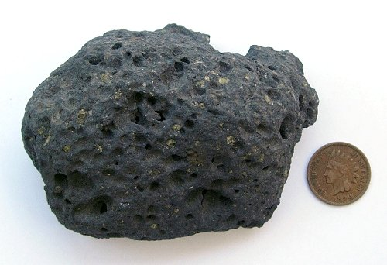
Examples of Igneous
Basalt Basalt

Slide 8
Igneous
Play

Slide 9
Sedimentary Rocks
Form when fragments of loose rock minerals settle together
2 processes
1. Compaction occurs buried under sediment (decreases volume)
2. Cementation occurs when mineral precipitates into pores and bind sediment

Slide 10
Origin of sed rock
Clastic-forms when fragments of pre-existing rocks are compacted or cemented together
Organic-forms from the remains of plants and animals
Chemical-forms when minerals precipitate from a solution or settle from a suspension

Slide 11
Deposition
Occurs when sediments are laid down on the ground or sink to the bottom of a body of water, final stage of the erosional process in which the movement of transported materials slows and they are dropped in another location.
Examples of Depositional environments?

Slide 12
Sedimentary Rock
Sequence the steps in the formation of sedimentary rock from evaporation.
1. Minerals are dissolved and carried into lakes and oceans by chemical weathering
2. Water evaporates and leaves behind dissolved minerals
3. the concentration of minerals reaches the saturation point

Slide 13
Sedimentary Rock
4. Crystal grains precipitate out of the solution and settle on the bottom
5. Layers of chemical sedimentary rocks called evaporates form (crystal grains precipitating out of a body of water)
6. Thick layers of evaporates can accumulate as evaporation removes freshwater

Slide 14
Sedimentary Rock
Provide information about:
1. past animals and plants
2. ancient rivers, lakes and shorelines
3. bedrock
Provide resources:
1. uranium
2. oil, natural gas and coal
3. building materials
4. phosphate and iron

Slide 15
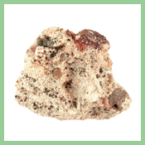
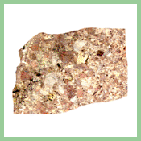
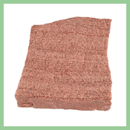
Examples of Sedimentary Rocks
Conglomerate Breccia Sandstone

Slide 16
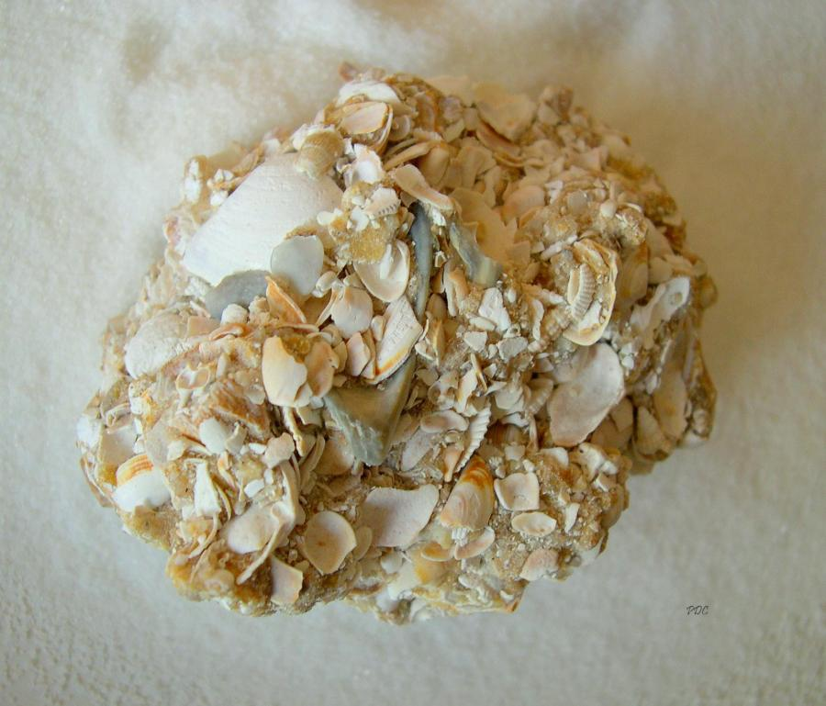
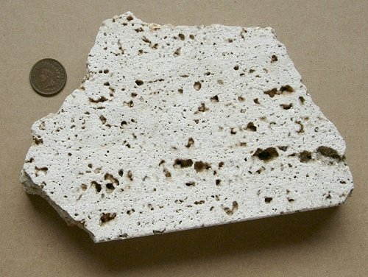
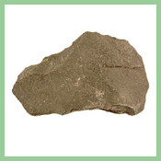
Examples of Sedimentary Rocks
Shale Coquina Travertine

Slide 17
Sedimentary
Play

Slide 18
Metamorphic Rock
Change rock by heat, pressure or chemical processes
1. Contact caused by contact with magma
2. Regional caused by change in temp and pressure (tectonic forces) (most metamorphic rock is formed with regional contact)

Slide 19
Metamorphic Rock
Foliated- Wavey layers/bands
Nonfoliated-Blocky shapes
Porphyroblast-large crystals

Slide 20
Metamorphic Textures
Texture | Shape of crystals | How formed? | Examples
Foliated | Flat, needle like | High pressure | Schist gneiss
Non-foliated | block | No pressure | Marble Quartzite
Porphyroblast | Large | Rearranges the atom | Garnet

Slide 21
Metamorphic Rocks
Conditions necessary for metamorphism
High Temp-can be caused by-
a. Igneous intrusion
b. buried deeply
High Pressure-can be caused by-
a. weight of above rock
b. mountain building

Slide 22
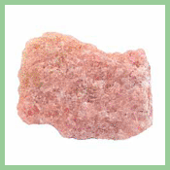
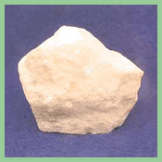
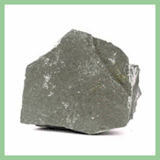
Metamorphic examples
Quartizite Marble Slate

Slide 23
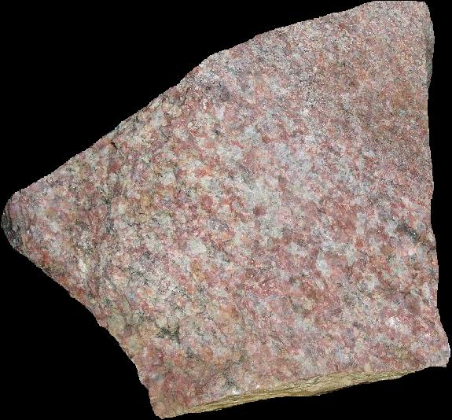
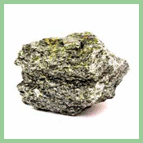
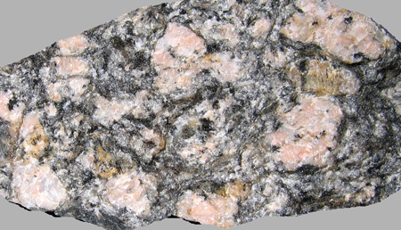
Metamorphic examples
Mica schist, granite gneiss, Augen gneiss

Slide 24
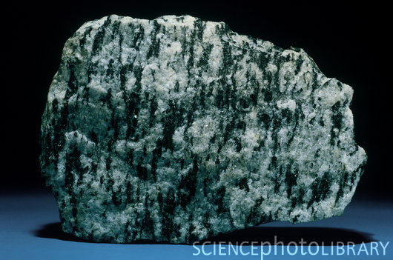
Metamorphic examples
Biotite gneiss

Slide 25
Metamorphic
Play

Slide 26
Rock animations
Play
Rock cycle interactive
Rock interactive

