Slide 1
What is Earth Systems???

Slide 2
What is Earth Systems???
The study of Earth and of the universe around it.
Like other sciences, it assumes that the causes of natural events, or phenomena can be discovered through careful observation and experimentation.

Slide 3
What are the Branches of Earth Systems???
Geology
Oceanography and Hydrology
Meteorology
Astronomy

Slide 4
Geology
Geology - The study of origin, history, and structure of Earth and the processes that shape Earth such as:
Elements
Minerals
Rocks
Soil

Slide 5
Geology
Play Pangea
Play plate tectonics
Magnetic strips of Ocean Floor
Play all the examples

Slide 6
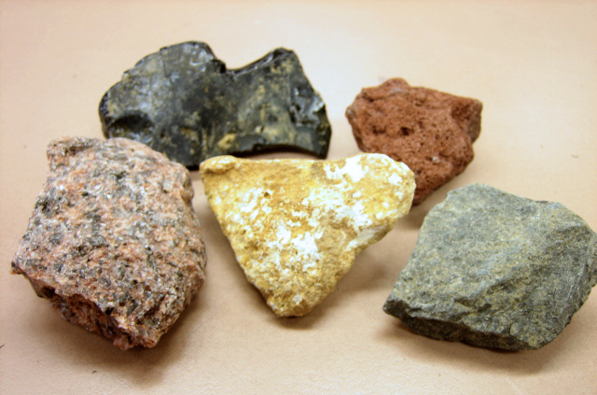
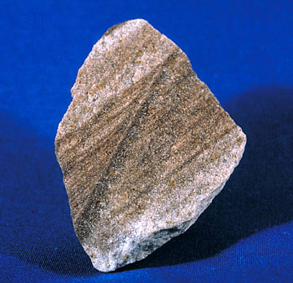
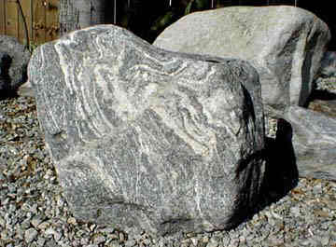
Geology
Metamorphic
Igneous
Sedimentary

Slide 7
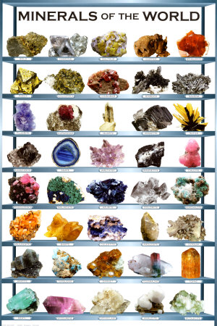
Geology- Minerals

Slide 8
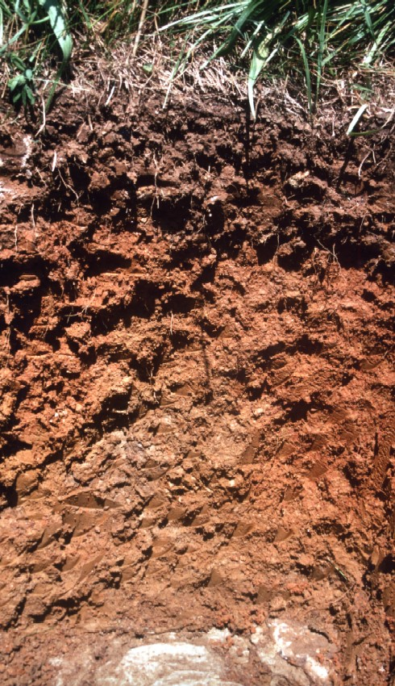
Geology-Soil

Slide 9
Oceanography and Hydrology
2. Oceanography - The scientific study of the ocean including:
Properties of Ocean water
Movements of ocean water
Characteristics of the ocean floor
Organisms that live in the ocean

Slide 10
Oceanography and Hydrology
Play hydrologic cycle

Slide 11
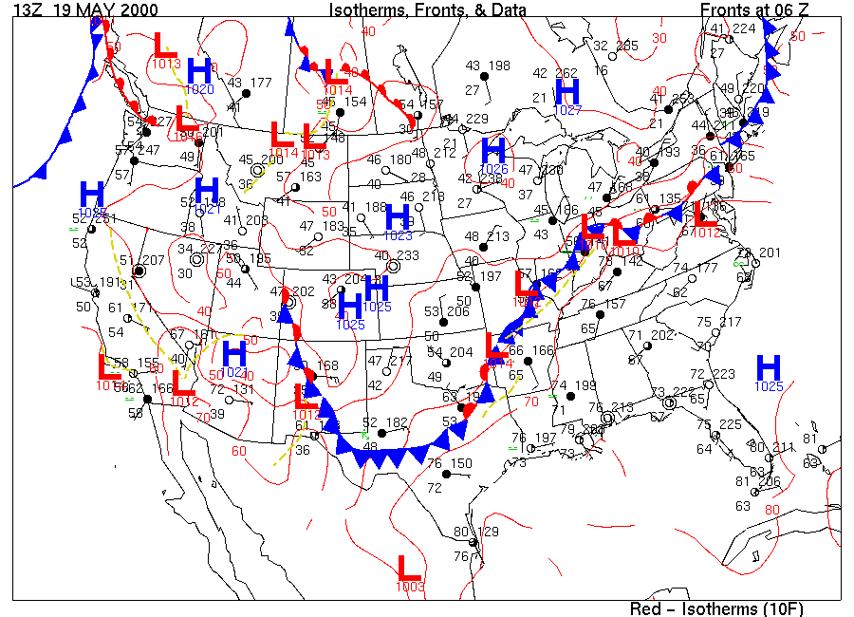
Meteorology
3. Meteorology - Scientific study of Earth’s atmosphere especially in relation to :
Weather
Climate

Slide 12
Astronomy
4. Astronomy - Scientific study of the universe.
This is one of the oldest branches of Earth Science.
Babylonians charted the positions of planets and stars nearly 4,000 years ago.

Slide 13
Astronomy
Play Earth at different places in space
Play Moon phases

